Slide 1
Circular Economy in the regional context: A systematic literature review and bibliometric analysis
8th International Workshop
Advances in Cleaner Production
13 – 15 November 2019
Sanya, China
Sanja Arsova, PhD Candidate
Prof. Andrea Genovese
Prof. Panagiotis Ketikidis
Dr. Adrian Solomon
The project has received funding from the European Union’s Horizon 2020 research and innovation programme under
the Marie Skłodowska-Curie European Training Networks grant agreement ReTraCE No 814247

Slide 2
AGENDA
01
02
03
PRELIMINARY FINDINGS
CONTEXT
METHODOLOGY
Concept of CE
Regional element
Research gap
SLR method
Bibliometrics
Search strategy
Findings - SLR
Findings - Bibliometrics
Future Research Agenda

Slide 3
The concept of Circular Economy (CE)
Focuses on optimizing the value and usability of products, materials and resources as long as possible, while minimizing waste.
(European Commission, 2015)
01
It entails gradually decoupling economic activity from the consumption of finite resources, and designing waste out of the system.
(Ellen MacArthur Foundation, 2012)
Reconsidering and redesigning the whole production and consumption system in order to close the existing loop and retain the highest utility.

Slide 4
The importance of the regional element
Regions are the most important administrative units for realising numerous European policies. (Avdiushchenko and Zajaç, 2019, Avdiuschenko, 2018)
CONTEXT OF THE STUDY AND RESEARCH GAP
The redistribution of the EU financial resources are regionally oriented (European Structural and Investment Funds (specifically the European Regional Development Fund (ERDF) and the European Social Fund (ESF), the Cohesion Fund, the European Agricultural Fund for Rural Development (EAFRD), and the European Maritime and Fisheries Fund (EMFF)). (Avdiuschenko, A. 2018)
Research Gap
….the macro level including international, national, regional and local actions is seen as very broad in current literature. (Vanhamaki et al., 2019)
…the micro, meso and macro definition is neither consistently used nor clearly defined among different authors….regions, with the scope between cities and countries, are considered as macro scale for Chinese CE Law (Moraga et al., 2019)…..regions are the connection between macro and micro scales when measuring CE eco-innovation; indicating a meso level (Smol et al., 2017).
01

Slide 5
02
METHODOLOGY
A systematic literature review (SLR) is useful for locating, selecting, analysing, appraising and evaluating the literature that is relevant to a particular research question. (Denyer and Tranfield, 2009)
Bibliometrics is a quantitative study of various aspects of literature on a topic and is used to identify the pattern of publication, authorship, and secondary journal coverage to gain insight into the dynamics of growth of knowledge in the areas under consideration. (S. Thanuskodi, 2010)

Slide 6
SEARCH STRATEGY
Context Keywords
Level 1
(“Circular Economy” OR “CE” OR “circular” OR “closed loop” OR “zero waste” OR “CE practices” OR “CE systems” OR “CE initiatives” OR “Industrial Ecology” OR “Industrial Symbiosis”)
Regional Level Keywords
Level 2
(“region” OR “regional context” OR “regional level” OR “meso level” OR “macro level” OR “regional development” OR “regional action plan” OR “regional strategy”)
Policy Keywords
Level 3
(“policy” OR “policy development” OR “policy mechanisms” OR “regional policy OR regional policies” OR “regulations” OR “legislation” OR “government” OR “governance models” OR “governance structure” OR “institutions”)
02
Out of scope Keywords
Level 4
(“consumer” OR “company level” OR “supply chain” OR “CSC” OR “micro level” OR “business
model” OR “operations” OR “logistics” OR “Life Cycle Assessment” OR “LCA” OR “engineering”)

Slide 7
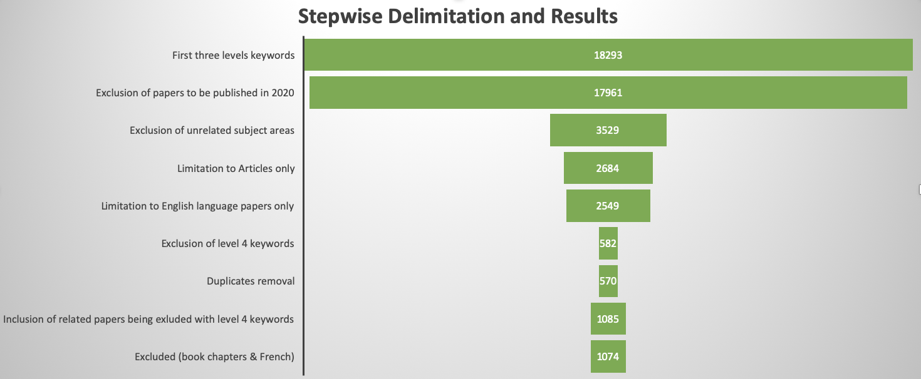
Manual Screening - Abstract
Criteria: Is it paper related to CE implementation?
NO – excluded 366
YES (Low) – excluded 99
YES (Medium) – kept 509
YES (High) – kept 100
Manual Screening – Full Paper
02
Criteria: Is the paper referring to regional CE implementation (or provides some considerations)?
NO – excluded 62
YES – kept 38

Slide 8
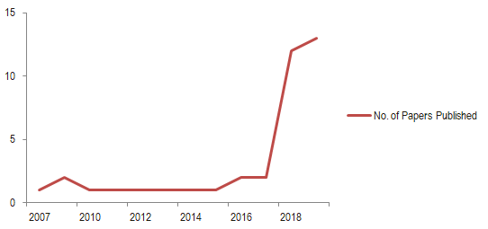
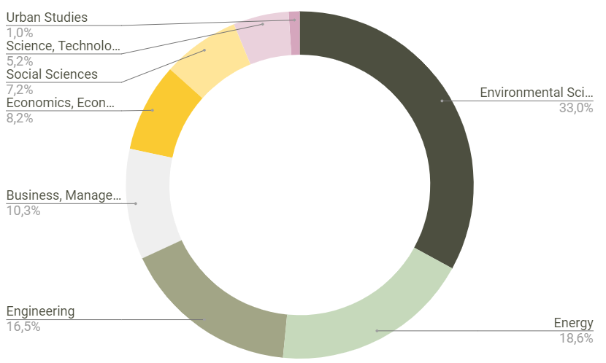
BIBLIOMETRIC ANALYSIS
No. Of Papers Published
Research Areas
03

Slide 9
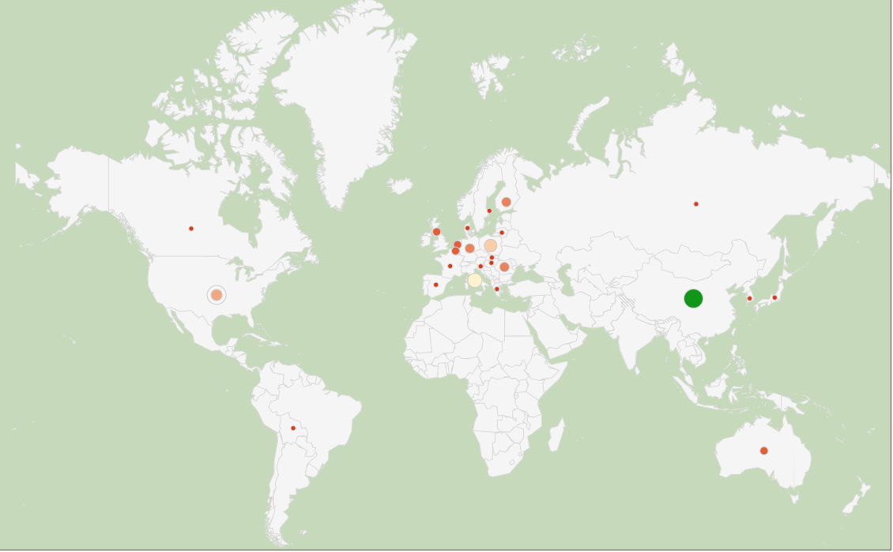
TOP CONTRIBUTING COUNTRIES
CHINA – 11 Papers
ITALY – 6 Papers
POLAND – 5 Papers
USA – 4 Papers
GERMANY– 3 Papers
FINLAND – 3 Papers
ROMANIA – 3 Papers
03

Slide 10
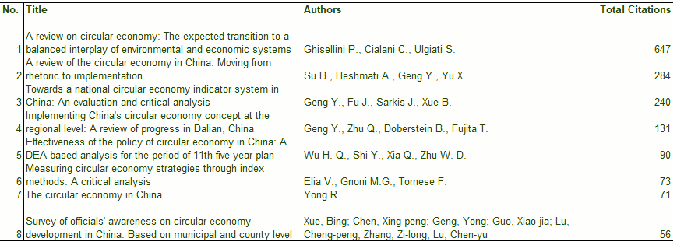
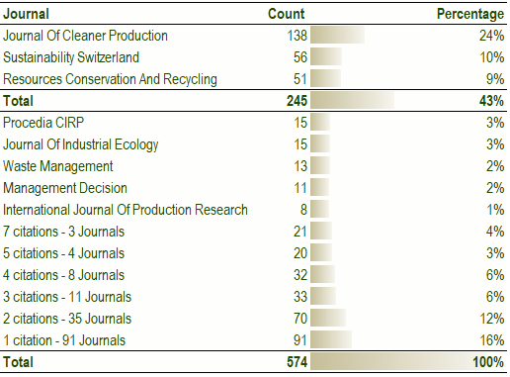
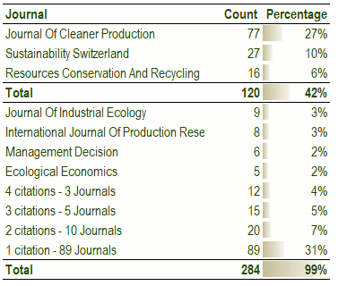
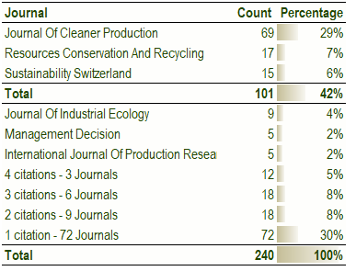
CITATIONS AND IMPACT
03
Most cited articles
Published in:
Journal of Cleaner Production
01
02
03

Slide 11
TOP FOUR JOURNALS
Most of the papers are published in
Journal of Cleaner Production (37%)
More than half of the papers are published in only 4 Journals (61%)
03

Slide 12
DIMENSIONS ANALYSED
1
2
3
4
5
GENERAL
MEASUREMENT
STAKEHOLDERS
LEGISLATION
DRIVERS/BARRIERS
Type of Paper
Applied Research Methods
Social Theories used/mentioned
Level of Analysis
Existence of indicators
Review/Design
Type of indicators
Tested (data, databases)
Stakeholder groups
Individual Stakeholders
Regional Stakeholders
Refers to policies
Refers to Directives
Refers to Strategic Documents
Drivers/Opportunities
Barriers/Challenges
Incentives/ Instruments

Slide 13
PRELIMINARY FINDINGS
Proposed & tested: System of possible indicators for evaluating progress towards CE at regional EU level– NUTS 2 (Poland), (Avdiushchenko and Zajaç, 2019)
Proposed & tested: CEPI (CE Potential Indicator) to quantify the potential for the development of a CE – NUTS 3 (county level, Romania) (Strat et al., 2018)
Tested: Regional CEDI (CE Development Index) calculation performed (Plastinina et al, 2019)
Mentioned: Guo-gang (2011) and Guogang and Chen (2011) proposed an index method for assessing the adoption of CE at the regional level (Elia et al., 2017)
Review of CE evaluation systems: Regional Circular Economy Development index & Evaluation of Regional Circular Economy Based on Matter Element Analysis (Banaite and Tamošiuniene, 2016).
Limited access and/or lack of data (Avdiushchenko, and Zajaç, 2019; Avdiushchenko, 2018; Strat et al., 2018)
Lack of regional CE monitoring framework (Avdiushchenko, 2018)
Term region used for:
EU, Asia, USA (Ranta et al., 2018; McDowall et al., 2017)
National level (Ferronato et al., 2019)
EU cities with peri-urban areas/metropolitan cities (Fratini et al., 2019; Obersteg et al., 2019)
County level (Strat et al., 2018)
NUTS 3 (Sayadi-Gmada et al., 2019)
NUTS 2 (Avdiushchenko and Zajaç, 2019)
NUTS 2 & NUTS 3 (Vanhamaki et al., 2019)
Chinese region, province, district
Mostly mentioning top decision-making bodies and organisations;
Only 13 (34%) papers refer to some sort of regional stakeholders.
Mostly international and national policies, strategies mentioned;
Only 12 (31%) papers refer to regional policies, strategic documents.
Lack of regional stakeholders
Lack of regional policies
Inconsistent use of the term region
Lack of regional measurements

Slide 14
FUTURE RESEARCH AGENDA
Attempts to: - Establish universal meaning for the term region; - Develop a regional measurement for CE implementation (monitoring framework, proposed databases and targets) - Identify and analyze the role/importance of regional stakeholders (groups) and mechanisms to involve other stakeholders - Identify the role/importance of regional arrangements and translation of higher level policies into regional ones - Identify drivers/incentives and barriers/challenges for regional CE implementation
A functional global circular economy can be built incrementally starting from the interconnection of national circular economies that rely on interconnected regional circular economies. (Strat et al., 2018)

Slide 15
Limitations
Limitation to only Journal articles (grey literature, conference papers, reviews not considered);
Excluding or overlooking other relevant articles due the manual search method;
Excluding related papers that have not been listed in one of these databases (Journals with lower rankings that might have relevant content);
Difficulty in generalising knowledge on CE implementation on regional level due to the low number of papers (38).

Slide 16
THANK YOU!
Contact details:
+ 30 698 6827693
asanja@seerc.org
SArsova1@sheffield.ac.uk
http://www.retrace-itn.eu/
www.seerc.org
https://www.linkedin.com/in/sanja-arsova-69151584/

Slide 17
Bibliography
Avdiushchenko, A., & Zajaç, P. (2019). Circular economy indicators as a supporting tool for european regional development policies. Sustainability (Switzerland), 11(11), 1–22. https://doi.org/10.3390/su11113025
Avdiushchenko, A. (2018). Toward a Circular Economy Regional Monitoring Framework for European Regions: Conceptual Approach. Sustainability, 10(12), 4398. https://doi.org/10.3390/su10124398
Banaite, D., & Tamošiuniene, R. (2016). Sustainable development: The circular economy indicators’ selection model. Journal of Security and Sustainability Issues, 6(2), 315–323. https://doi.org/10.9770/jssi.2016.6.2(10).
Denyer, D., Tranfield, D., 2009. Producing a systematic review. In: Buchanan, A., Bryman, A. (Eds.), The SAGE Handbook of Organizational Research Methods. Sage Publications Ltd, London, pp. 671–689.
Elia, V., Gnoni, M. G., & Tornese, F. (2017). Measuring circular economy strategies through index methods: A critical analysis. Journal of Cleaner Production, 142, 2741–2751. https://doi.org/10.1016/j.jclepro.2016.10.196
EMF (2012) Towards the Circular Economy: Economic and Business Rationale for an Accelerated Transition. Ellen MacArthur Foundation.
European Commission (2015) Communication from the Commission to the European Parliament, The Council, The European Economic and Social Committee and the Committee of the Regions: Closing the loop - An EU action plan for the Circular Economy, Brussels.
Ferronato, N., Rada, E. C., Gorritty Portillo, M. A., Cioca, L. I., Ragazzi, M., & Torretta, V. (2019). Introduction of the circular economy within developing regions: A comparative analysis of advantages and opportunities for waste valorization. Journal of Environmental Management, 230(April 2018), 366–378. https://doi.org/10.1016/j.jenvman.2018.09.095
Fratini, C. F., Georg, S., & Jørgensen, M. S. (2019). Exploring circular economy imaginaries in European cities: A research agenda for the governance of urban sustainability transitions. Journal of Cleaner Production, 228, 974–989. https://doi.org/10.1016/j.jclepro.2019.04.193
McDowall, W., Geng, Y., Huang, B., Barteková, E., Bleischwitz, R., Türkeli, S., … Doménech, T. (2017). Circular Economy Policies in China and Europe. Journal of Industrial Ecology, 21(3), 651–661. https://doi.org/10.1111/jiec.12597
Obersteg, A., Arlati, A., Acke, A., Berruti, G., Czapiewski, K., Dąbrowski, M., … Knieling, J. (2019). Urban Regions Shifting to Circular Economy: Understanding Challenges for New Ways of Governance. Urban Planning, 4(3), 19. https://doi.org/10.17645/up.v4i3.2158
Plastinina, I., Teslyuk, L., Dukmasova, N., & Pikalova, E. (2019). Implementation of circular economy principles in regional solid municipal waste management: The case of Sverdlovskaya Oblast (Russian Federation). Resources, 8(2). https://doi.org/10.3390/resources8020090
Ranta, V., Aarikka-Stenroos, L., Ritala, P., & Mäkinen, S. J. (2018). Exploring institutional drivers and barriers of the circular economy: A cross-regional comparison of China, the US, and Europe. Resources, Conservation and Recycling, 135(September 2017), 70–82. https://doi.org/10.1016/j.resconrec.2017.08.017
Sayadi-Gmada, S., Rodríguez-Pleguezuelo, C. R., Rojas-Serrano, F., Parra-López, C., Parra-Gómez, S., García-García, M. del C., … Manrique-Gordillo, T. (2019). Inorganic waste management in greenhouse agriculture in Almeria (SE Spain): Towards a circular system in intensive horticultural production. Sustainability (Switzerland), 11(14). https://doi.org/10.3390/su11143782
Strat, V. A., Teodor, C., & Săseanu, A. S. (2018). The characterization of the Romanian circular economy’s potential, at county level. Amfiteatru Economic, 20(48), 278–293. https://doi.org/10.24818/EA/2018/48/278
Thanuskodi, S. (2010). Bibliometric Analysis of the Journal Library Philosophy and Practice from 2005- 2009. Library Philosophy and Practice (e-journal), p. 1-7. Retrieved from http://www.webpages.uidaho.edu/~mbolin/thanuskodi-lpp.htm
Vanhamaki, S., Medkova, K., Malamakis, A., Kontogianni, S., Marisova, E., Dellago, D. H., & Moussiopoulos, N. (2019). Bio-based circular economy in European national and regional strategies. International Journal of Sustainable Development and Planning, 14(1), 31–43. https://doi.org/10.2495/SDP-V14-N1-31-43

