Slide 1



Circular Economy Indicators for Supply Chains:
A Systematic Literature Review
Tommaso Calzolari, Andrea Genovese
Operations Management & Decision Sciences Division
Sheffield University Management School

Slide 2
Contents
Background of the Study & Problem Statement
Main Research Objectives & Aims
The Research Method
Systematic Literature Review Preliminary Findings
Research Gaps

Slide 3
Background
Today’s SCs are complex, global and linear
  Lack of adequate penalties for their externalities (EMF, 2013; Ciardiello et al., 2018)
Organizations are increasingly accounted for their environmental and social impacts (Acquaye et al., 2018) as:
  Scarcity of natural resources,
  increased generation of waste materials
Closing the loop of products and materials is considered essential

Slide 4
Circular Economy: A definition
“CE is a sustainable development initiative with the objective of reducing the societal production-consumption systems' linear material and energy throughput flows by applying materials cycles, renewable and cascade-type energy flows to the linear system. CE promotes high value material cycles alongside more traditional recycling and develops systems approaches to the cooperation of producers, consumers and other societal actors in sustainable development work […] “
Korhonen et al. (2017)

Slide 5
Circular Supply Chains
Circular Supply Chains (CSCs) are at the backbone of operationalising the CE concepts at the micro level. CSCs:
  Include a reverse element, commonly known as reverse supply chain
  Are able to emphasise products and materials reuse and recycle, integrating renewable resources and reducing the waste
  Create value by keeping products and materials in use after their end-of-life (Korhonen et al., 2017)

Slide 6
Problem Statement
Many companies are adopting CE interventions along their SCs
Tracking the effectiveness of the transition of SCs towards higher levels of circularity requires specific indicators
Such measurement systems should be able:
  To go beyond organizational boundaries, taking a supply chain and life-cycle perspective
  To take a systemic view on economic, social and environmental aspects
  To assess the level SCs are able to reduce the waste streams they produce

Slide 7
Current Gaps
Results from a preliminary analysis shows that there is not an established standard to measure the level of circularity of SCs
  Highly fragmented field of study
  Huge availability of environmental indicators, but no agreement on “what to measure”
Need for an attempt to assess the state-of-the-art of current indicators, their uptake and potential developments

Slide 8
Research Objectives
To identify current indicators in the context of circular supply chains literature
To characterise them according to the dimensions they consider and the decision they aim to support
To identify a restricted set of key performance indicators which could be used to keep track of the effectiveness of CE interventions in CSCs

Slide 9
A SLR on CE Indicators for SCs
To date, no systematic review has been carried out in the field of Circular Economy indicators at a supply chain level.
Systematic review is useful to locate, select, analyse, appraise and evaluate the literature relevant to particular research question (Denyer and Tranfield, 2009).
Moreover, systematic literature reviews offer brief and holistic view of research outcomes, in order to clarify the general understanding on particular field and identification of relevant gaps in the previous literature (Pittaway et al., 2004; Tranfield; 2003).

Slide 10
Methodology
SCOPUS (and Web of Science). The review was conducted among international peer-reviewed journals
Generic Keywords have been chosen to maximize the number of articles to be included in the analysis
Keyword String | Number of Results
( ( "Circular Economy" OR "Circular" OR "Closed-loop" OR "Reverse" OR "Industrial Ecology" OR "Sustainab*" ) AND "Supply Chain*" AND ( "indicator*" OR "measure*" OR "assess*" OR "index" ) ) | 2596
( ( "Circular Economy" OR "Circular" OR "Closed-loop" OR "Reverse" OR "Industrial Ecology") AND "Supply Chain*" AND ( "indicator*" OR "measure*" OR "assess*" OR "index" ) ) | 543
( ( "Circular Economy" OR "Circular" OR "Closed-loop" OR "Industrial Ecology" ) AND "Supply Chain*" AND ( "indicator*" OR "measure*" OR "assess*" OR "index" ) ) | 345
( ( "Circular Economy" OR "Circular" OR "Industrial Ecology" ) AND "Supply Chain*" AND ( "indicator*" OR "measure*" OR "assess*" OR "index" ) ) | 176
( ( "Circular Economy" OR "Circular") AND "Supply Chain*" AND ( "indicator*" OR "measure*" OR "assess*" OR "index" ) ) | 91

Slide 11
A SLR on CE Indicators for SCs
543 relevant peer-reviewed research papers
18 years (2000 - 2019)
Body of literature concerned with the development of indicators and metrics , aiming to track the transition towards Circular Economy at a supply chain level
This systematic literature review is used to discover existing approaches used by SCM scholars, which can help characterizing Decision-Making in a Circular Supply Chain context as well as to identify and address a relevant gap to stimulate research for this thesis.

Slide 12
Inclusion/Exclusion criteria
Only include articles in English language
Only include peer-reviewed studies
Exclude articles that do not develop/employ any indicator
Exclude articles that do not develop any indicator
Exclude articles that do not consider the circular dimension of SCs

Slide 13
Sample of Articles
No | Study / Author(s) | Supply Chain Decision Supported | Type of Supply Chain
1 | Pelton et al, Hotspot Scenario Analysis: Comparative Streamlined LCA Approaches for Green Supply Chain and Procurement Decision Making Pelton and Smith Hotspot Scenario Analysis | SC Performance Assessment | Forward supply chain
2 | Yılmaz Balaman et al, Network design and technology management for waste to energy production: An integrated optimization framework under the principles of circular economy | SC Network Design | Circular Supply Chain
3 | Saxena L.K et al, Tactical supply chain planning for tyre remanufacturing considering carbon tax policy | SC Network Planning | Closed Loop Supply Chain

Slide 14
Relevancy of the Reviewed Articles
The remaining 216 articles will be further analysed in relation to their relevance
183 relevant studies have been used for this systematic review, whereas another 33 studies were not relevant to the study objectives.
Those articles were evaluated based on few criteria including decision supported, industry of implementation, methodology Dimension . The selection will be further analysed in relation to their relevance
Criteria | Number of Studies | Relevance
Studies developing an indicator/multiple indicators in order to explicitly evaluate the performance of CSCs | 88 | Included
Studies employing an indicator/multiple indicators for CSCs in the context of wider Decision-Making models and problems | 95 | Included
Studies contributing to the CE literature without developing any indicator | 33 | Excluded

Slide 15
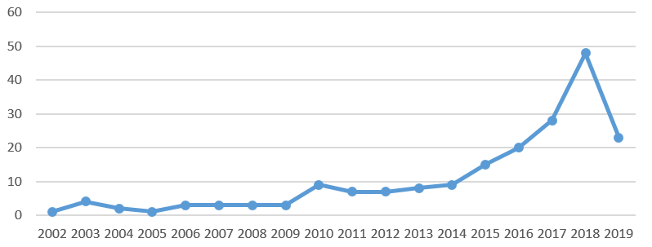
Historical Series of Articles
An exponential increase can be observed after 2014
(Just partial figures for 2019)

Slide 16
Most Popular Journals
The top contributors are the Journal of Cleaner Production and Sustainability, both of the academic field of Environmental Science
Some contributions also from the Management Science domain (International Journal of Production Economics, International Journal of Production Research)

Slide 17
Countries of Origin
Iran, China, and India countries with more contributions followed by some European countries.

Slide 18
Research Methodologies Employed
Research Methodologies
LCA
Optimisation
Conceptual
MCDM

Slide 19
Dimensions Considered
Economic
Only 7 papers consider the 3 dimensions simultaneously
Less than 15% of all the indicators integrate the social dimension
24
Environmental
26
Social
7
2
13

Slide 20
Dimensions Considered
Increasing number of indicators that integrate environmental and social issues, and that are characterised by a multi-criteria approach

Slide 21
Economic Dimension
More frequent Economic Indicators | Papers
SC Cost | 39
SC Profit | 16
Risk | 4
Time responsiveness | 3
Quality | 2
NPV | 2
Inventory level | 1

Slide 22
Environmental Dimension
More frequent Environmental Indicators | Papers
CO2e emissions | 14
Residual waste | 11
Energy use | 8
Land Use | 7
Virgin resource use | 5
Climate Change | 5
Recovered waste | 4
Water Use | 4
Greenhouse Gas Emissions (GHG) | 3
Energy demand (CED) | 3
Global Warming Potential (GWP) | 3
Exergy | 1
TAP | 1
More than 50 different indicators employed
Are they all necessary? Is there some correlation?

Slide 23
Social Dimension
No agreement on stakeholders to be involved.
  Employees?
  Customers?
  Suppliers?
More frequent Social Indicators | Papers
Job creation | 5
Work damages | 2
SR Fund optimal usage | 2
Customer service | 2
Decent Work, Work Conditions | 1
Supplier commitment | 1

Slide 24
Research Gaps
Gap #1 – Most of the approaches does not account for the social dimension.
Gap #2 – A lot of environmental indicators available. Are they correlated?
Gap #3 – Lack of a multi dimensional and established synthetic indicators

Slide 25
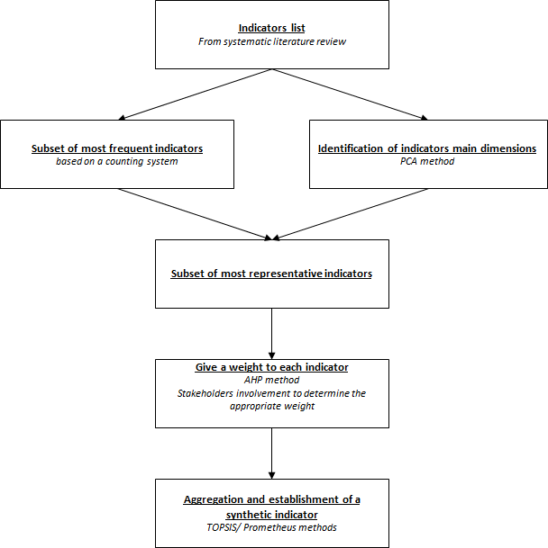
A Potential Synthetic Indicator

Slide 26
Thank you

