Slide 1
Understanding Generalisaiton through Visualisation
Christopher Wild

Slide 2
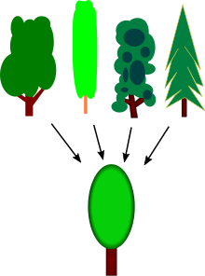
What is Generalisation?

Slide 3
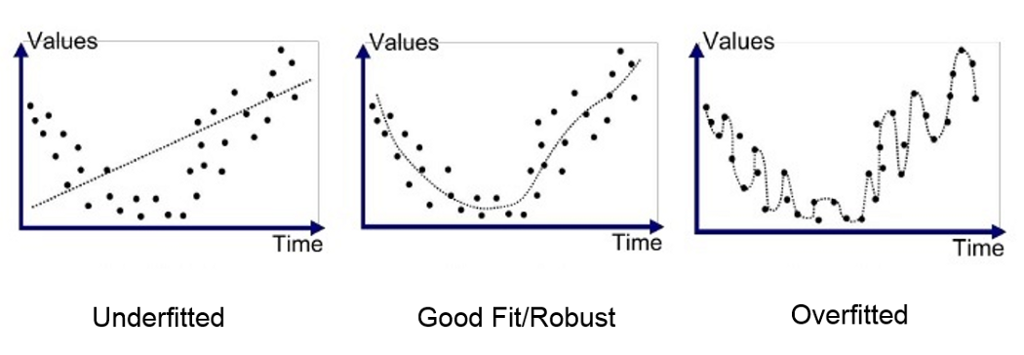
How do models overfit?
Regression
https://medium.com/swlh/machine-learning-how-to-prevent-overfitting-fdf759cc00a9

Slide 4
How do models overfit?
SVM
https://towardsdatascience.com/understanding-support-vector-machine-part-2-kernel-trick-mercers-theorem-e1e6848c6c4d

Slide 5
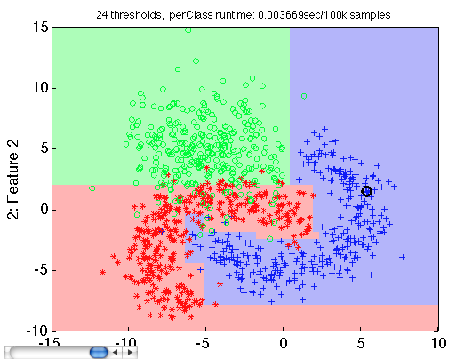
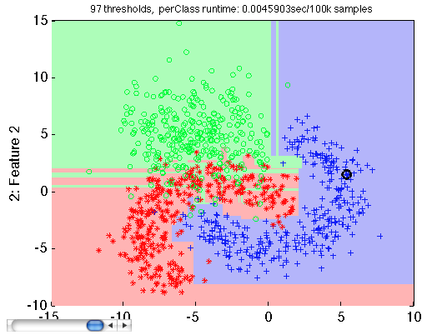
How do models overfit?
Decision Tree
https://doc.perclass.com/perClass_Toolbox/guide/classifiers/decision_trees.html

Slide 6
How to spot overfitting?
https://towardsdatascience.com/food-for-thought-paper-tuesday-d163f8339d26

Slide 7
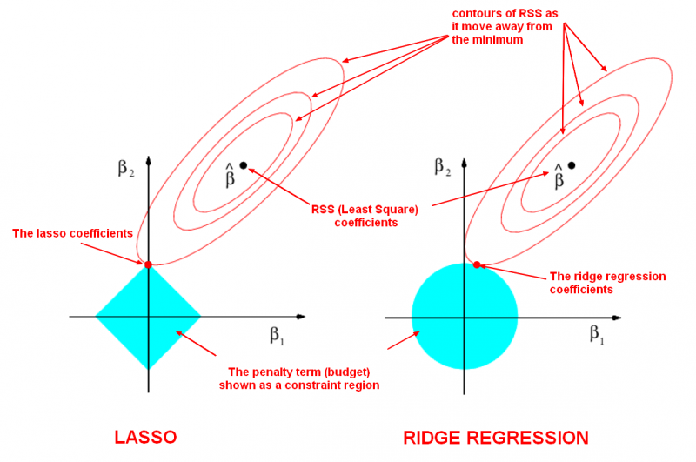
Regularization Through Visualisation!
http://ethen8181.github.io/machine-learning/regularization/regularization.html

Slide 8
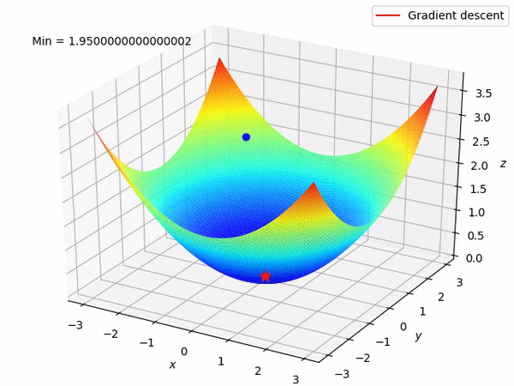
Gradient Descent Quickly
https://suniljangirblog.wordpress.com/2018/12/03/the-outline-of-gradient-descent/

Slide 9
Regularization Through Visualisation!
http://ethen8181.github.io/machine-learning/regularization/regularization.html

Slide 10
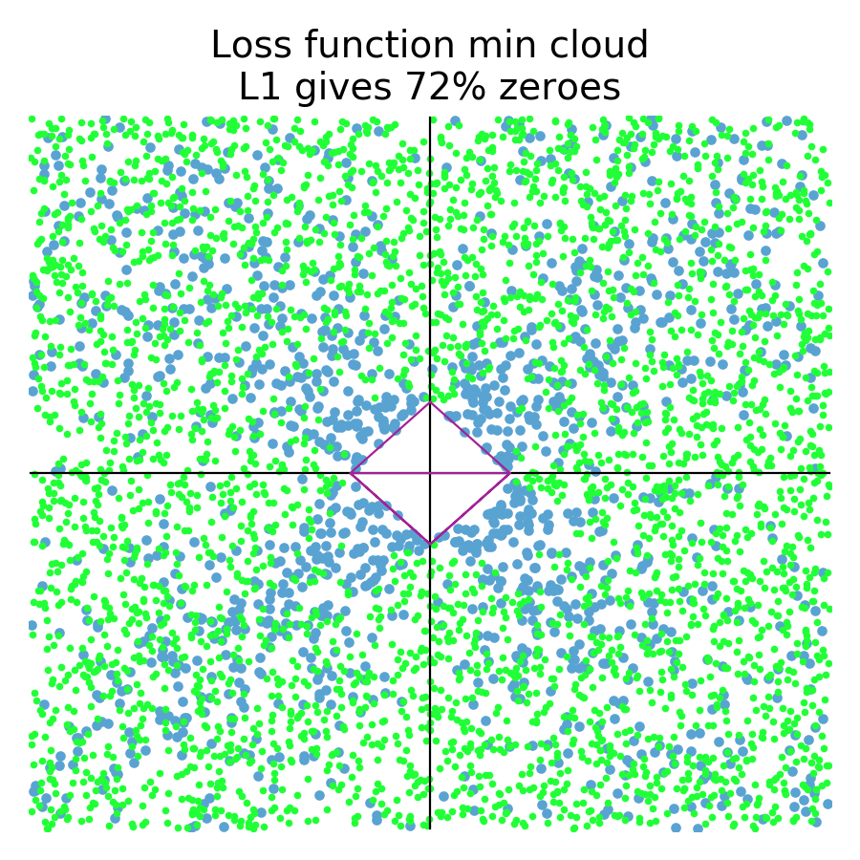
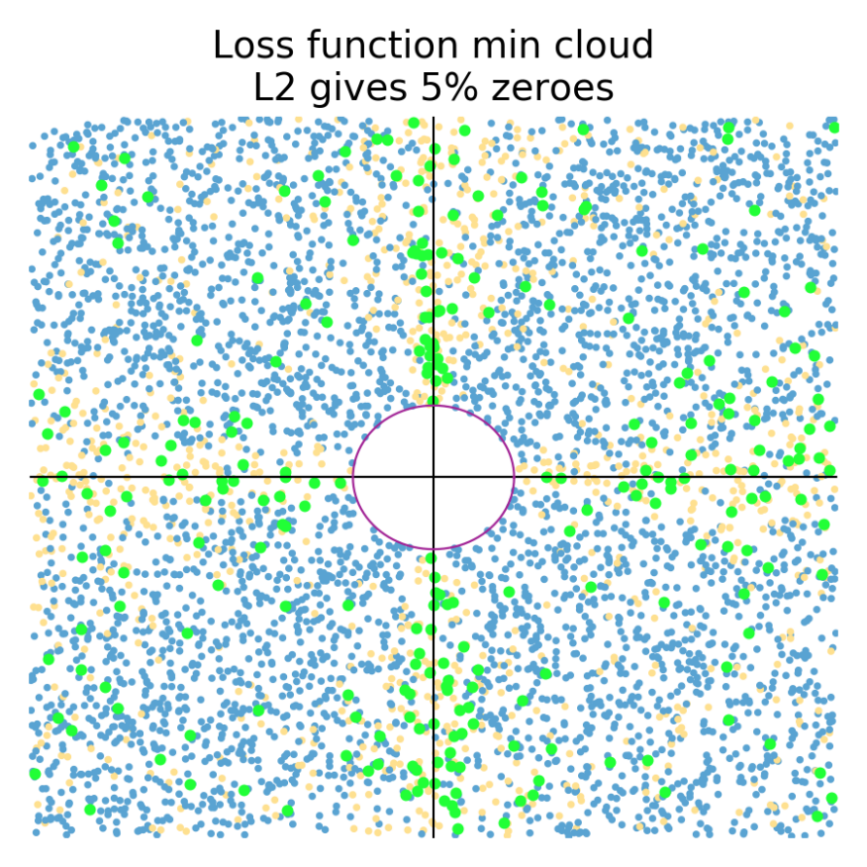
Regularization Through Visualisation!
https://explained.ai/regularization/index.html

