Slide 1
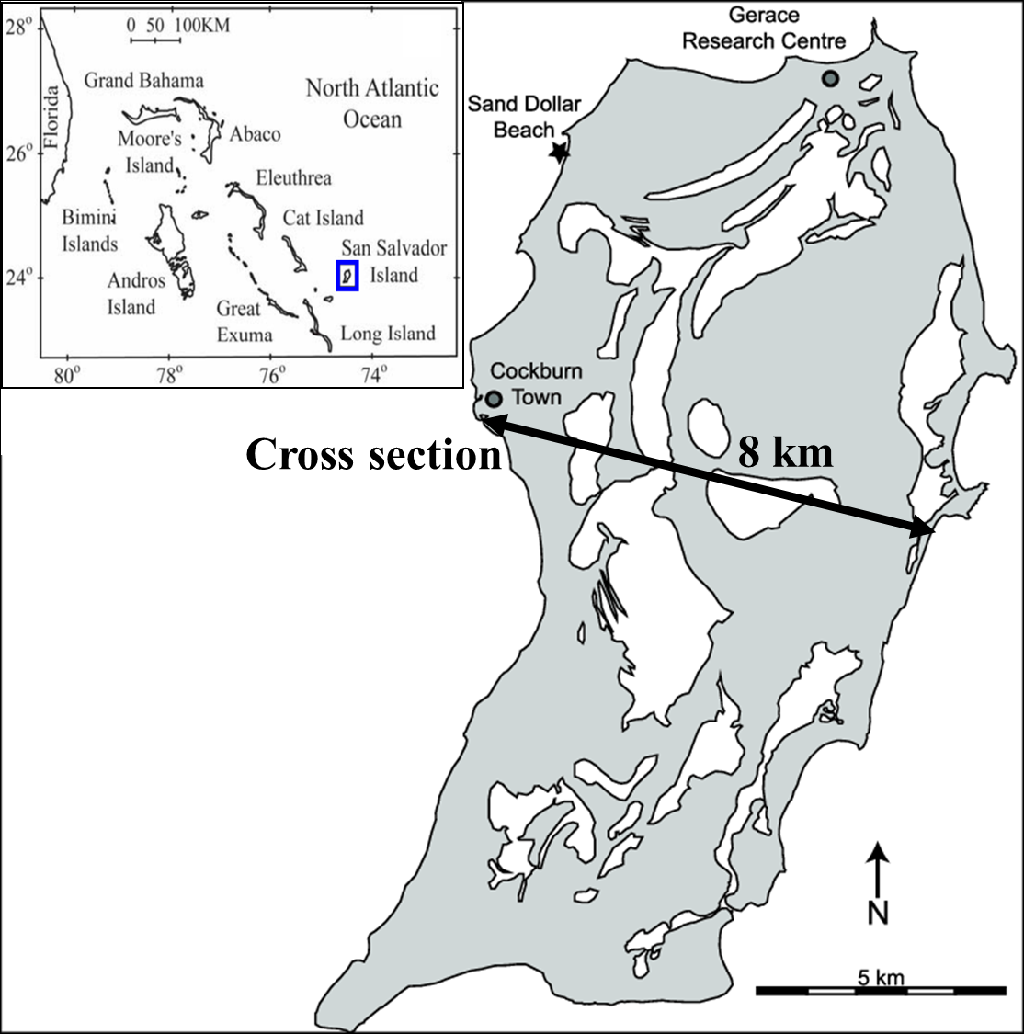
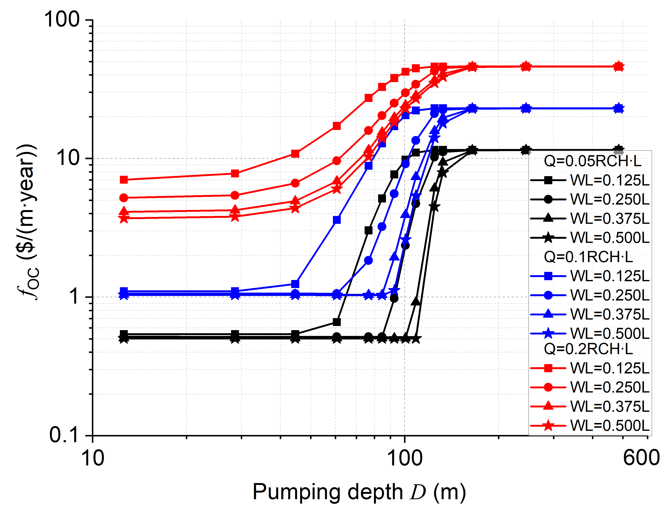
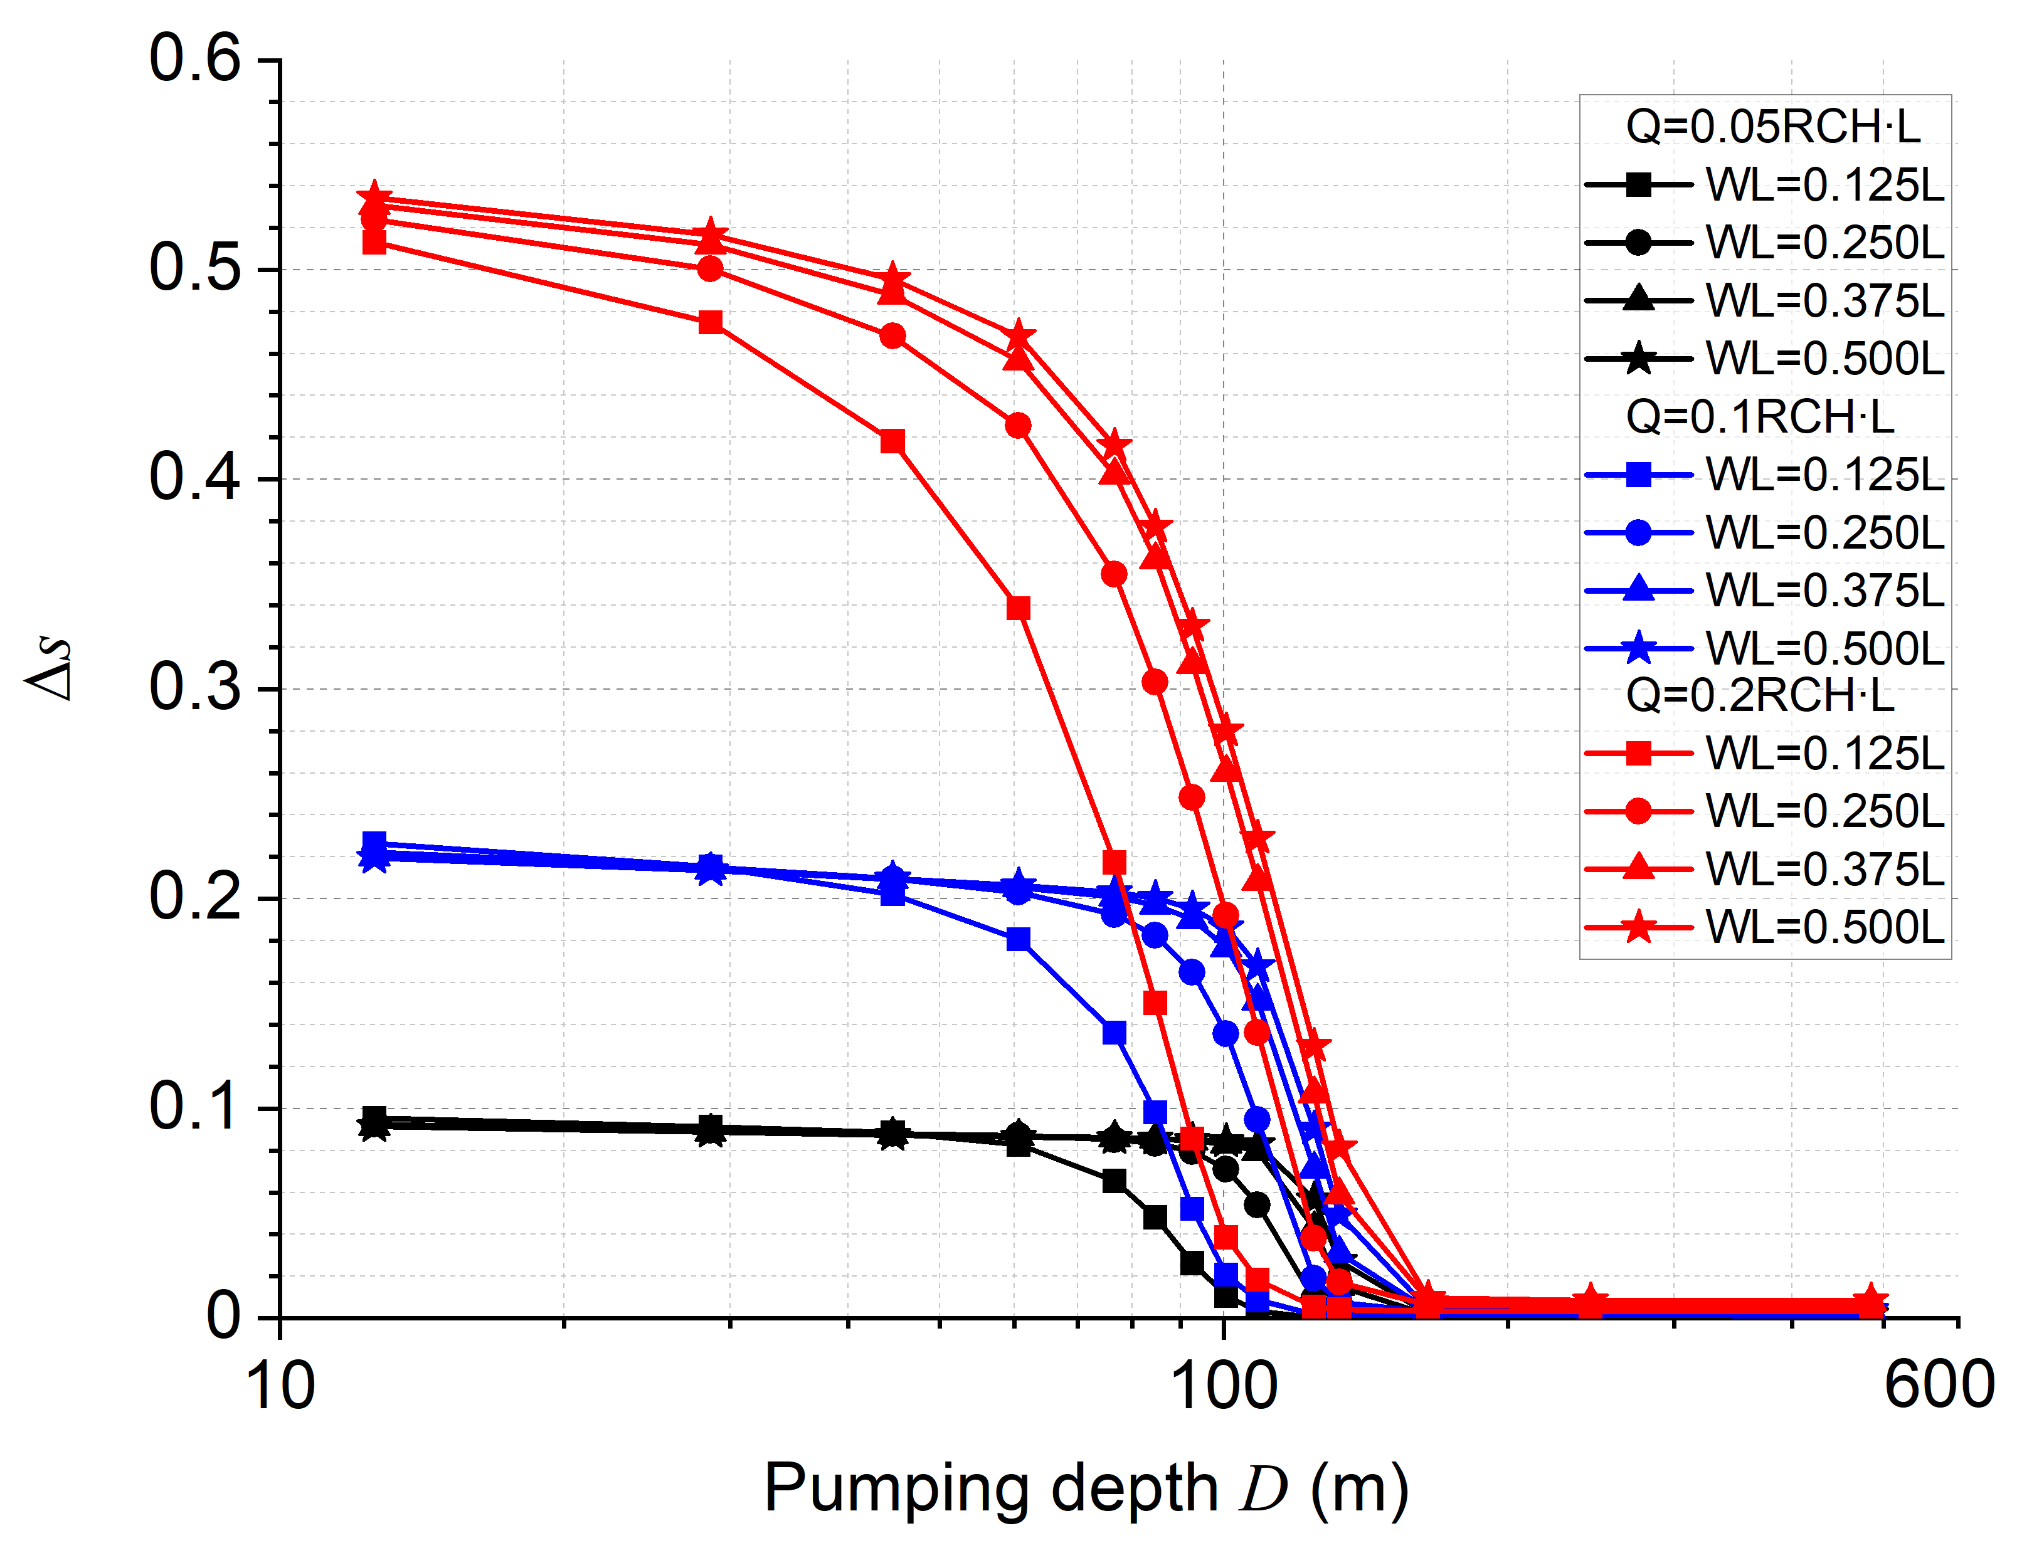
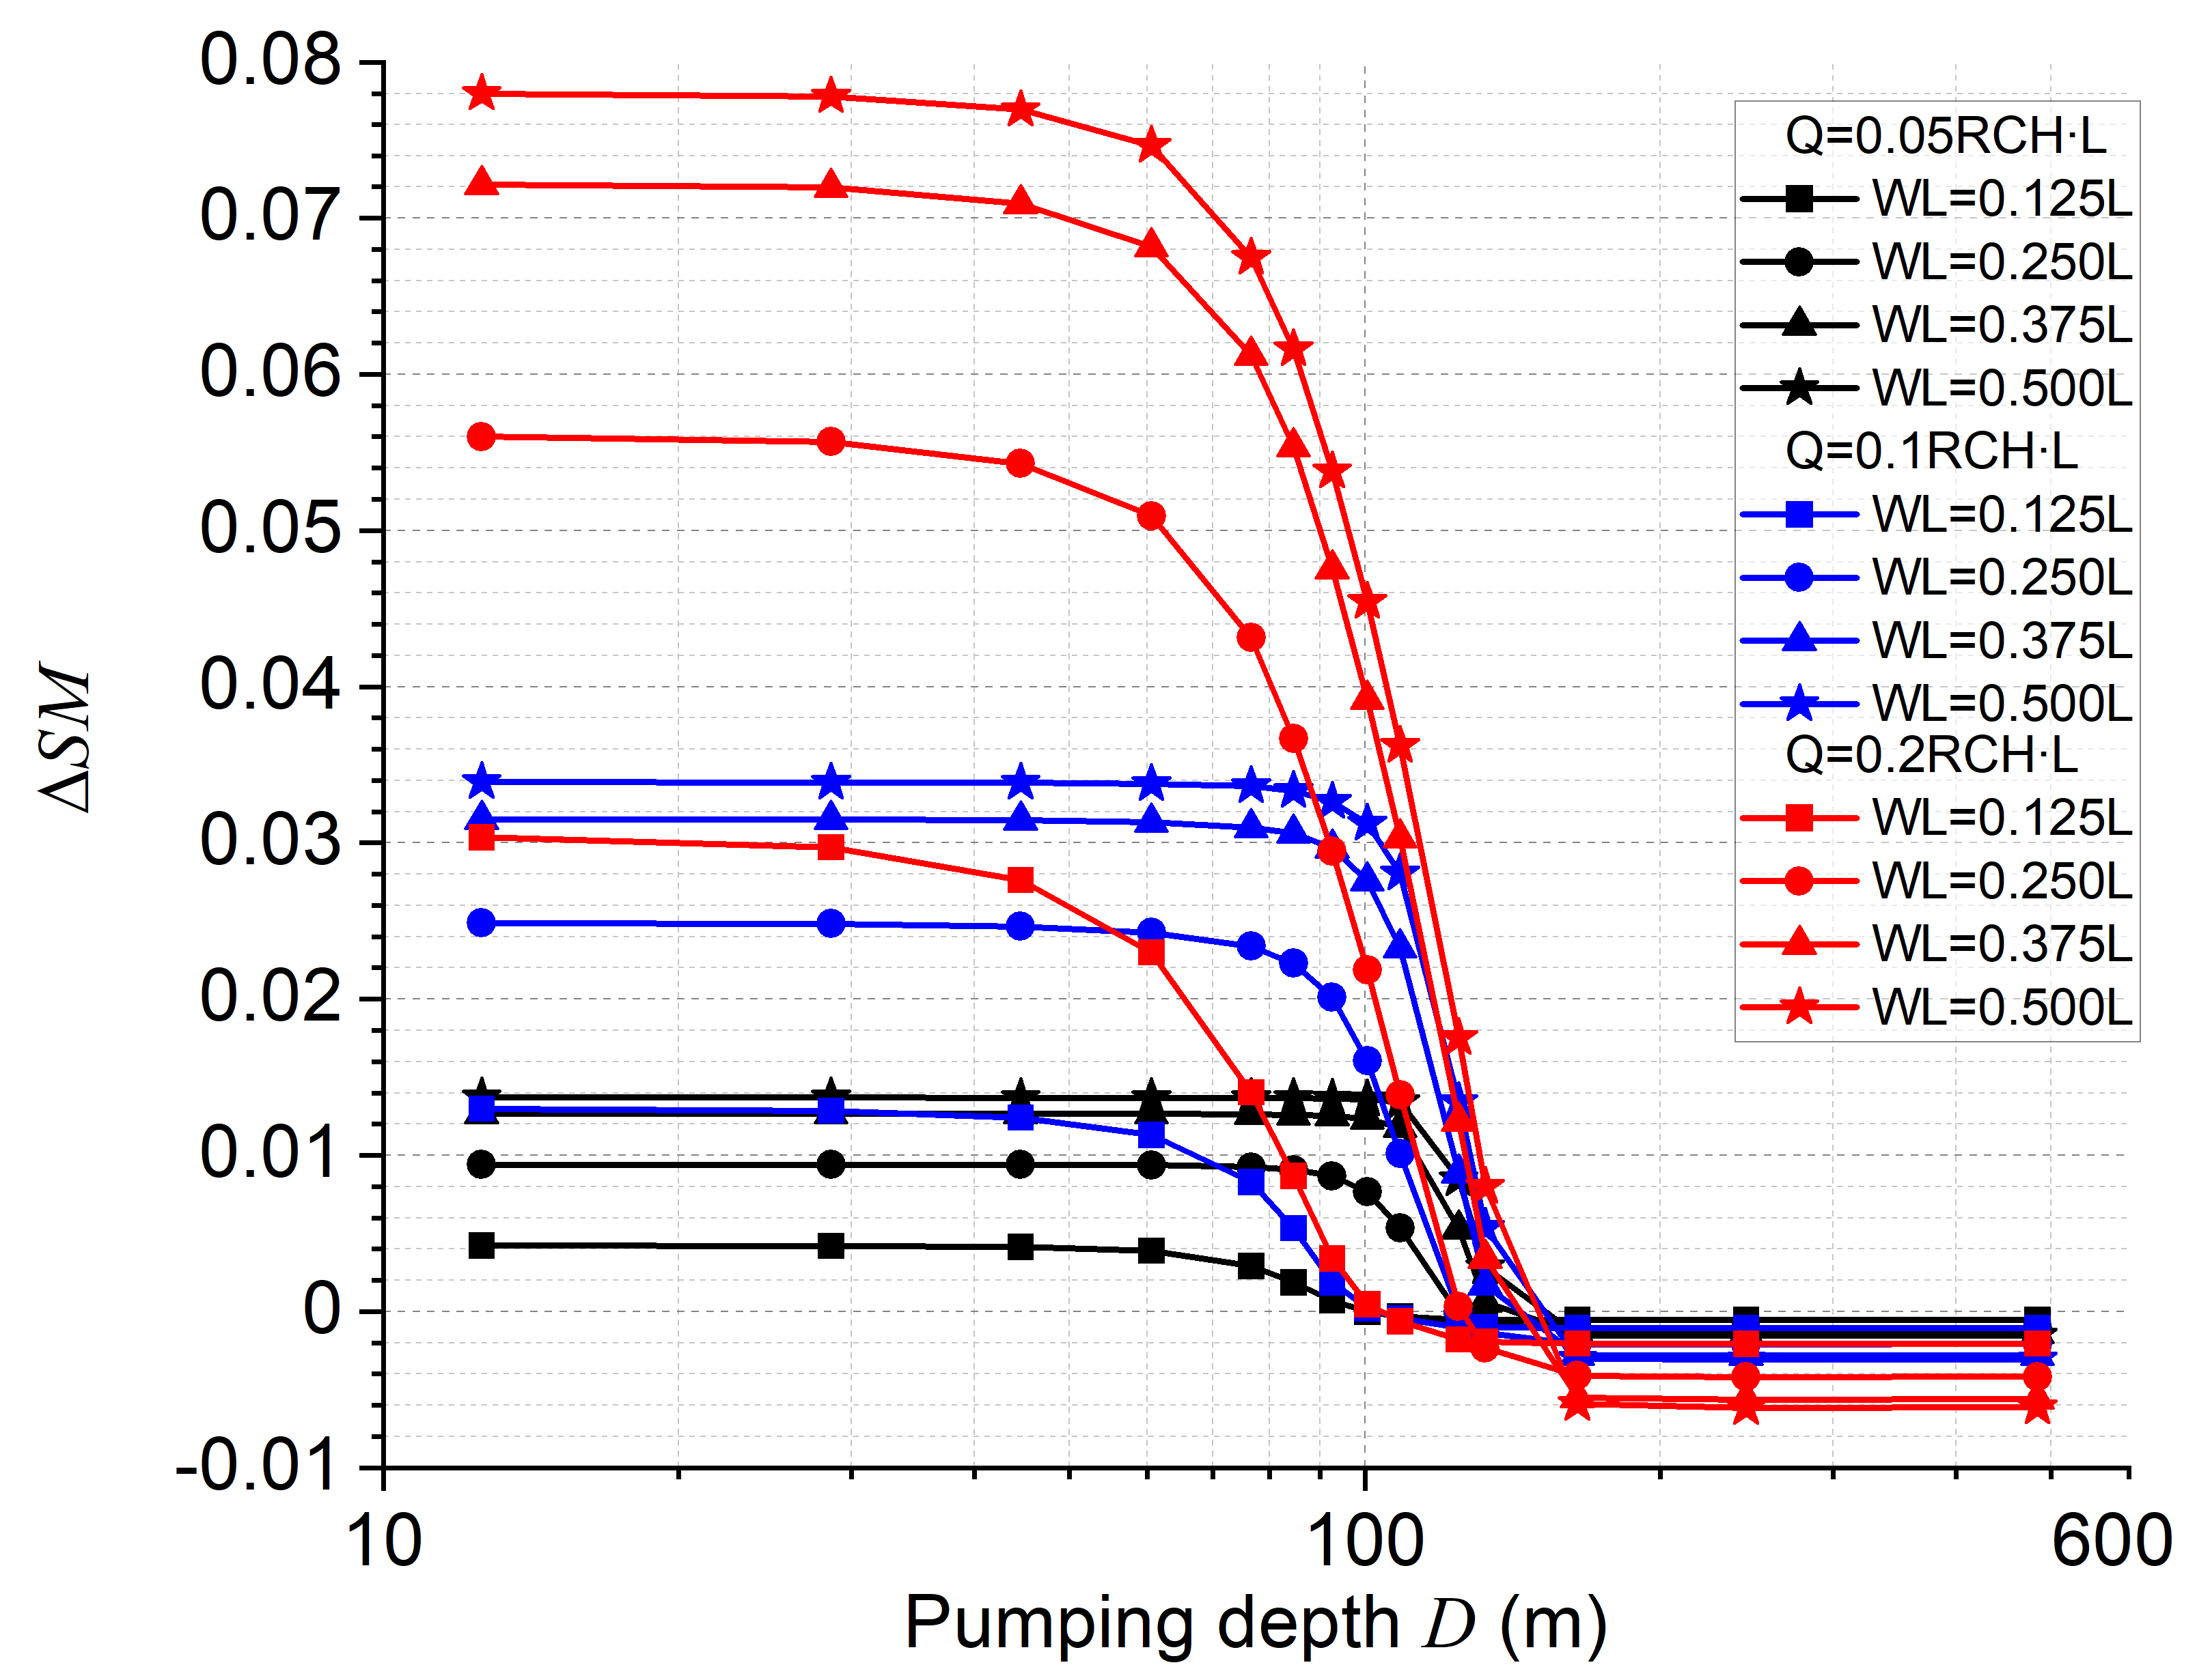
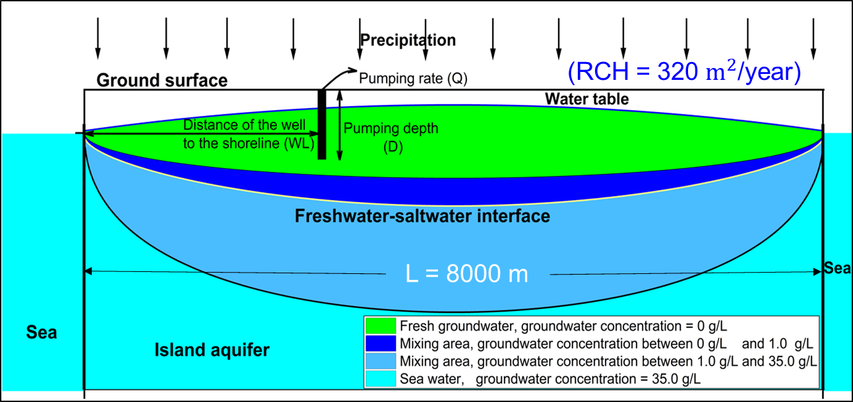
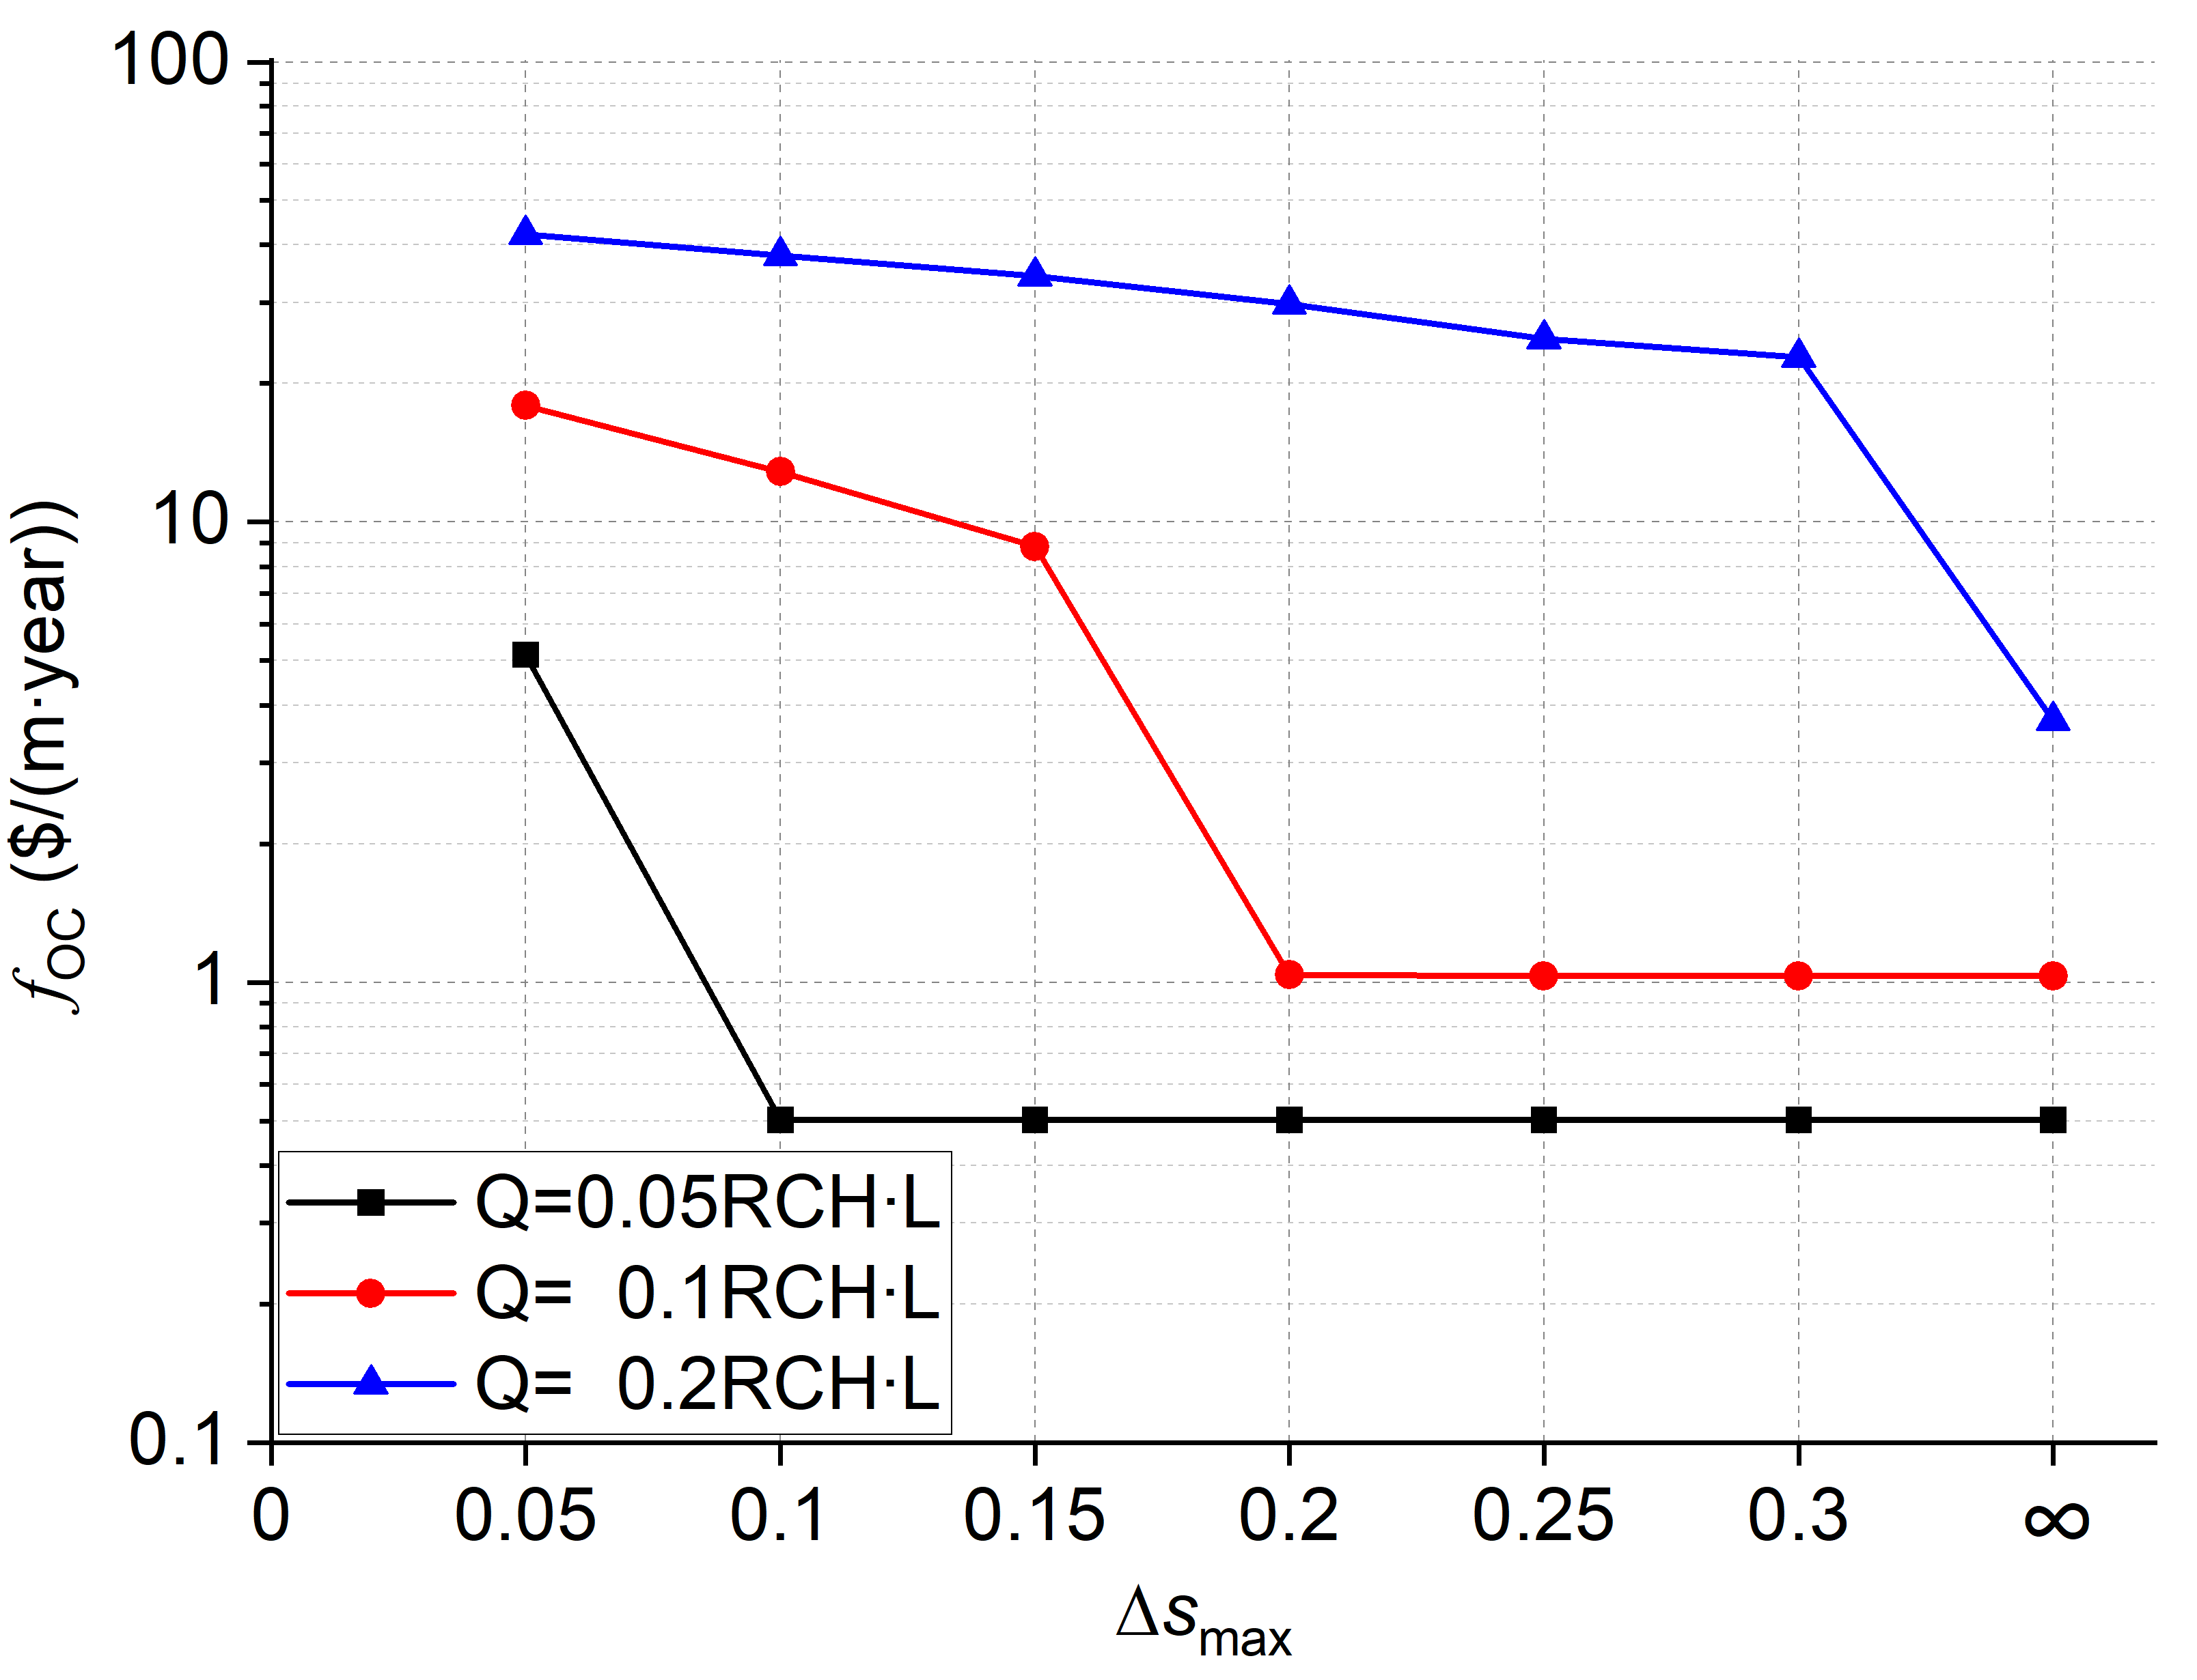
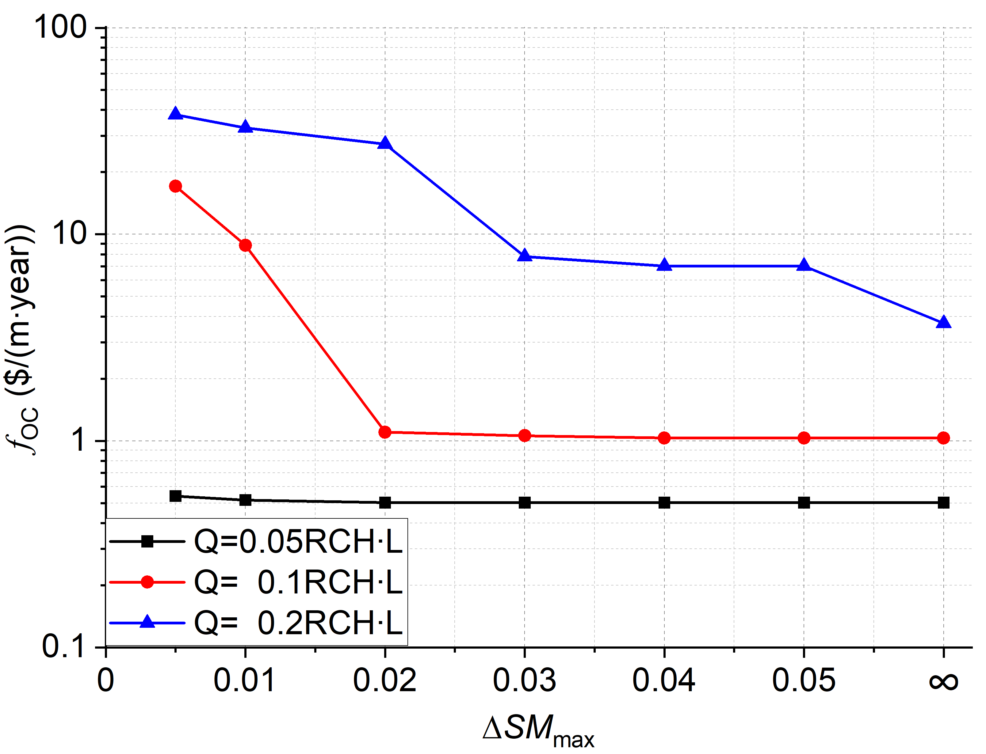
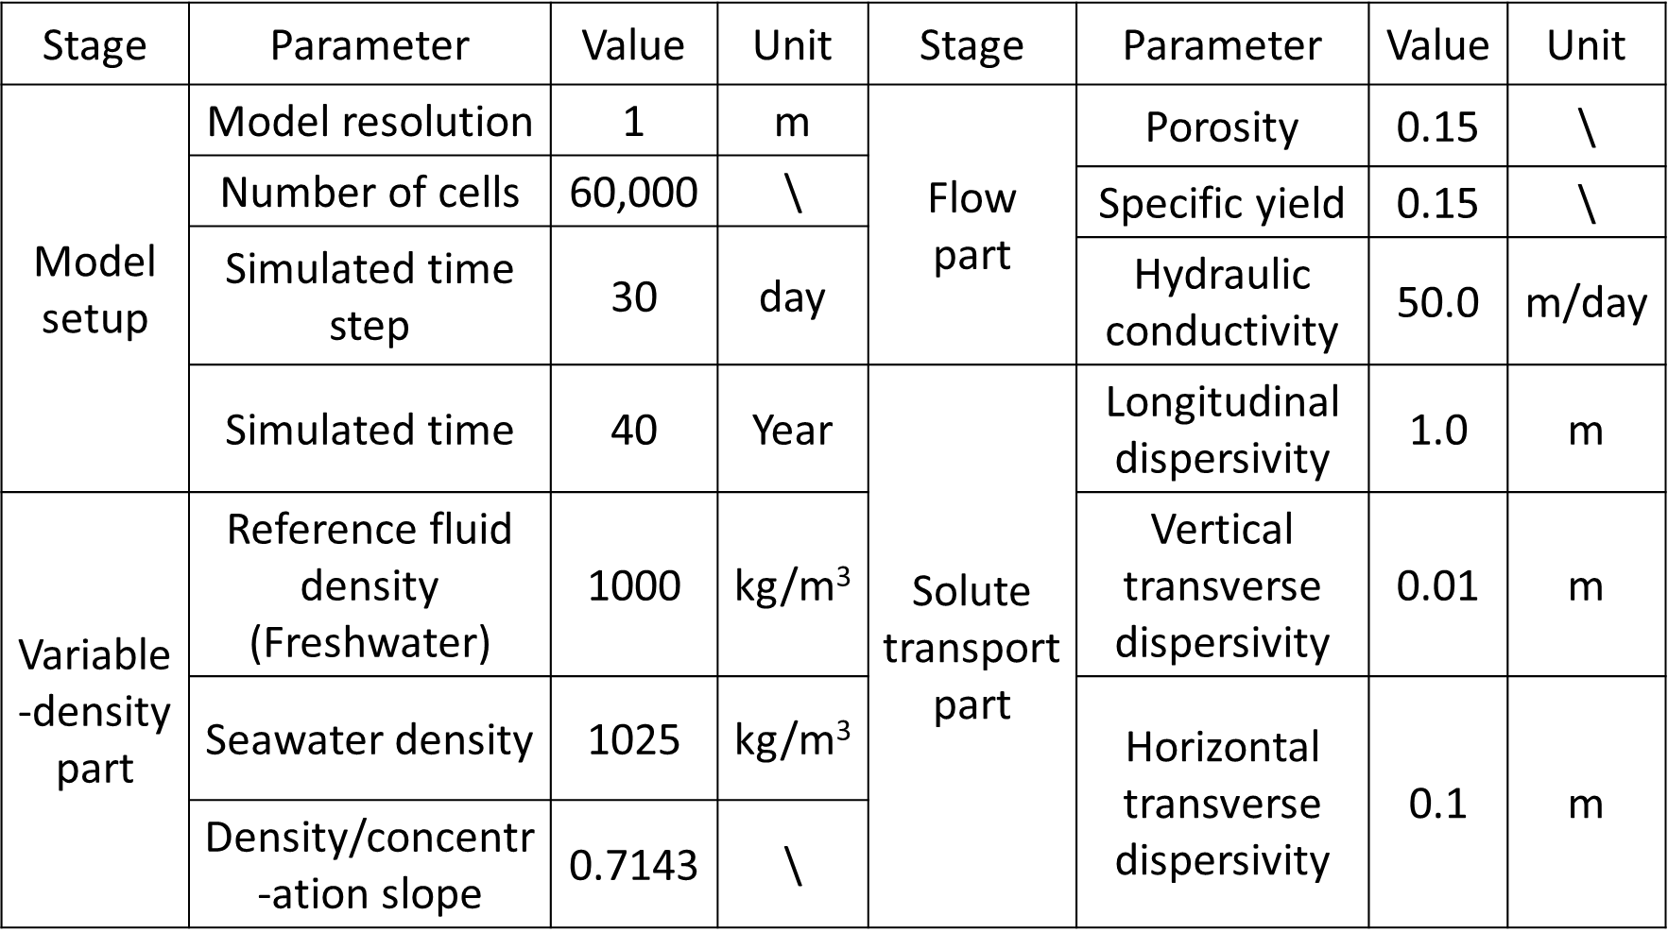
Management of Island Aquifers by Simulation-Optimization
Weijiang Yu¹, Domenico Baù¹, Alex S. Mayer², Lauren Mancewicz³,
Mohammadali Geranmehr¹
¹ Department of Civil and Structural Engineering, University of Sheffield, Sheffield, UK
² Department of Civil Engineering, the University of Texas at El Paso, TX, USA
³ Department of Civil, Environmental, and Geospatial Engineering, Michigan Technological University, Michigan, USA
1. Background and study site
4. Sensitivity scenarios for the pumping and threshold values
of $∆s_{max}$, $∆{SM}_{max}$
For most island communities, subsurface freshwater is the sole source of freshwater resources and local domestic water fully depends on pumping groundwater. As subsurface freshwater is fragile to be polluted by saltwater under pumping activities, it is necessary to make an optimal strategy to encounter a balance between groundwater extraction and seawater intrusion (SWI) control for the sake of sustainable development.
Table 3. Decision variable values considered for candidate pumping strategies for island aquifer management
Table 4. Sensitivity scenarios for threshold values of each hydrogeological constraint
Decision variables | Scenarios
Q (m²/year) | 0.05RCH$∙$L |  | 0.1RCH$∙$L |  | 0.2RCH$∙$L
WL (m) | 0.125L |  | 0.250L | 0.375L | 0.500L
D (m) | 13 | 29 | 45 | 61 | 77 | 85 | 93
 | 101 | 109 | 125 | 133 | 165 | 245 | 485
Scenarios | 1 | 2 | 3 | 4 | 5 | 6
$$∆s_{max}$$ | 0.05 | 0.1 | 0.15 | 0.2 | 0.25 | 0.3
$$∆{SM}_{max}$$ | 0.005 | 0.01 | 0.02 | 0.03 | 0.04 | 0.05
Determining an optimal strategy and its operation cost rely on the management problem formulation, namely the requirements for SWI control. This research is to investigate impacts of SWI control on the cost of groundwater supply in island aquifers, centered on San Salvador Island, Bahama.
Note. L represents island width, 8000m; RCH denotes aquifer recharge, 0.2 m/year.
5. Impact of pumping strategies on $f_{OC}$ and constraint indicators
Figure 1. Location map of San Salvador Island. Grey part indicates land area while the white represents surface water, including hypersaline lakes and blue holes.
2. Development of groundwater simulation
model
Figure 3. Simulated operation cost ($f_{OC}$), $∆s$ and $∆SM$ in the designed pumping scenarios
It shows that $f_{OC}$ nearly keeps constant if pumping from the deep, but has two behaviors when pumping at the shallow aquifer, monotonically increasing or remarkably increasing after slightly decreasing. Given Q and D, $f_{OC}$ goes smaller if well moves away the shoreline, being the smallest at island center.
In contrary to $f_{OC}$, $∆s and ∆SM$ exhibit in the concave shape with the increase of D. When Q and D are specified, it reveals $∆s$ and $∆SM$ go higher with the well getting close to the island center.
Numerical code SEAWAT version 4 is used to simulate variable density groundwater flow and solute (salt) transport ^{[1]}.
6. Impact of single SWI control on the optimal operation cost
a
b
Figure 4a and 4b show that when Q is equal to 0.05RCH$∙$L, all constrained $f_{OC}$ are nearly same as that in the unconstrained case. Compared with the constraint of $∆SM$, optimal schemes limited by $∆s$ are more sensible to the increase of Q, causing higher $f_{OC}.$
Figure 2. Conceptualization of the numerical groundwater model
Table 1. Main parameter values used for developing island groundwater system under the natural state
Figure 4. Optimal $f_{OC}$ in different cases of (a) $∆s_{max}$ and (b) $∆{SM}_{max}$
Note. Symbol $∞$ represents $∆s_{max}$ and $∆{SM}_{max}$ are large enough, representing the pumping is in the unconstrained case.
7. Impact of multiple SWI controls on the optimal operation cost
Table 5. Optimal $f_{OC}$ under the combinations of two constraint conditions
Scenarios | $$∆s_{max}$$ (1) | $$∆{SM}_{max}$$ (2) | Optimal $f_{OC}$ ($/(m$∙$year))
 |  |  | Q= 0.05RCH$∙$L | $$\text{Q}\text{=}$$ $$\text{0.}\text{1}\text{RCH}∙\text{L}$$ | $$\text{Q}\text{=}$$ $$\text{0.}\text{2}\text{RCH}∙\text{L}$$
1 | 0.1 | 0.01 | 0.52⁽²⁾ | 12.86⁽¹⁾ | 37.99 ⁽¹⁾
2 | 0.1 | 0.03 | 0.50^{U} | 12.86⁽¹⁾ | 37.99 ⁽¹⁾
3 | 0.1 | 0.05 | 0.50^{U} | 12.86⁽¹⁾ | 37.99 ⁽¹⁾
4 | 0.2 | 0.01 | 0.52⁽²⁾ | 8.85⁽²⁾ | 32.81⁽²⁾
5 | 0.2 | 0.03 | 0.50^{U} | 1.83 | 29.72⁽¹⁾
6 | 0.2 | 0.05 | 0.50^{U} | 1.04⁽¹⁾ | 29.72⁽¹⁾
7 | 0.3 | 0.01 | 0.52⁽²⁾ | 8.85 ⁽²⁾ | 32.81⁽²⁾
8 | 0.3 | 0.03 | 0.50^{U} | 1.06⁽²⁾ | 25.05
9 | 0.3 | 0.05 | 0.50^{U} | 1.03^{U} | 22.82 ⁽¹⁾
Table 5 reveals that optimal operation cost values subject to simultaneous constraints on $∆s$ and $∆SM$ in some cases, depending on the selection of $∆s_{max}$ and $∆{SM}_{max}$. In most cases, only one constraint results binding, while the other has no impact on optimal $f_{OC}$.
3. Formulation of the management problem
The problem of finding optimal pumping designs includes three decision variables: 1) pumping rate (Q), 2) distance of the well to the shoreline (WL), 3) pumping depth (D). Cost of groundwater supply, termed as operation cost ($f_{OC}$), consists of two parts, pump cost $f_{p}$ and treatment cost $f_{t}$ ^{[2, 3, 4]}.
Note. Values are with a superscript representing the SWI constraint that results binding for the optimal pumping scheme, that is, “(1)” for constraint 1, “(2)” for constraint 2. “U” denotes none of the constraints is binding, whereas cost values that depend simultaneously on two constraints are indicated with bold characters.
Objective function minimize the $f_{OC}$ of extracting groundwater:
minimize $f_{OC}\text{(}\text{Q}\text{, }\text{h}\text{, }\text{C}\text{)}$=$f_{p}\text{(}\text{Q}\text{, }\text{h}\text{, }\text{C}\text{)}$+$f_{t}\text{(}\text{Q}\text{, }\text{C}\text{)}$
8. Conclusions and future development
Constraints
Conclusions
$f_{OC}$ always reaches the smallest at the island centre when Q and D are given, but extracting groundwater at the centre is not conducive to SWI control. It is a conflict between the financial budget and SWI control, and thus it is necessary to search the optimal pumping strategy to encounter a balance between them.
In general, optimal pumping strategies move towards the shoreline with the increase of Q, and optimal scheme needs to move deeper when SWI controlling is stricter.
Future development
Develop a surrogate-optimization framework to replace expensive simulation-optimization system to determine the optimal management scheme and its $f_{OC}$ in practice.
1.limitation of water table drawdown at the well:
$∆s$(Q, WL, D)$≤∆s_{max}$
2.limitation of aquifer salt mass increase:
$∆SM\text{(}\text{Q}\text{,}\text{WL}\text{,}\text{D}\text{)}≤∆{SM}_{max}$
3.allowable range of each decision variable:
$$\text{0.}\text{05}\text{RCH}∙\text{L}≤Q≤\text{0.}\text{2}\text{RCH}∙\text{L}$$
0.05L $≤WL≤$ 0.5L
1 m $≤D≤$ 485 m
Table 2. Explanation of parameters used in the management problem
Acknowledgements
References
Parameter | Explanation | Unit
h=h(Q, WL, D) | Water table elevation over the pumping well | m
C=C(Q, WL, D) | Concentration of pumped groundwater | m³/kg
$∆s$(Q, WL, D) | Ratio of the drawdown over the pumping well | /
$∆SM$(Q, WL, D) | Ratio of aquifer salt mass increase | /
${∆s}_{max}$ and ${∆SM}_{max}$ are user-defined threshold values, reflecting the degree of SWI control.
Some of the authors of this study have been supported in part by the UK EPSRC grant EP/T018542/1 and the US NSF grant 2022278.
[1] Guo W, Langevin CD, 2002, User’s guide to SEAWAT: A computer program for simulation of three-dimensional variable-density ground-water flow: U.S. Geological Survey Techniques of Water-Resources Investigations, book 6, chap. A7, 77 p.
[2] Mayer AS, Kelley CT, Miller CT, 2002. Optimal design for problems involving flow and transport phenomena in saturated subsurface systems. Advances in Water Resources, 25(8–12):1233–1256.
[3] Baù DA, Mayer AS, 2006. Stochastic management of pump-and-treat strategies using surrogate functions. Advances in Water Resources, 29: 1901-1917.
[4] Avlonitis SA, Avlonitis DA, Panagiotidis Th, 2012. Experimental study of the specific energy consumption for brackish water desalination by reverse osmosis. International Journal on Energy Research, 36: 36-45.

