Slide 1


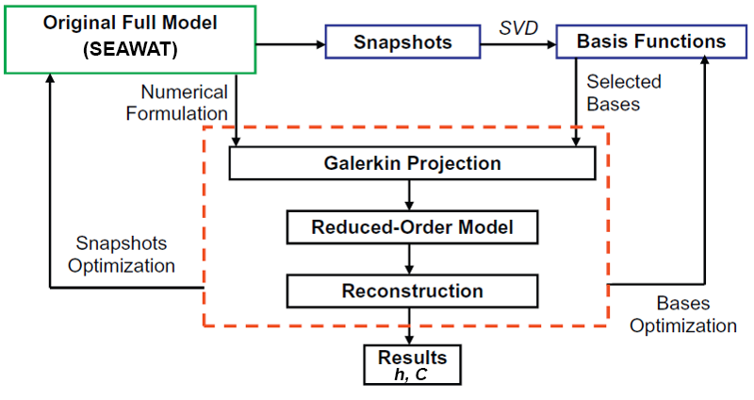
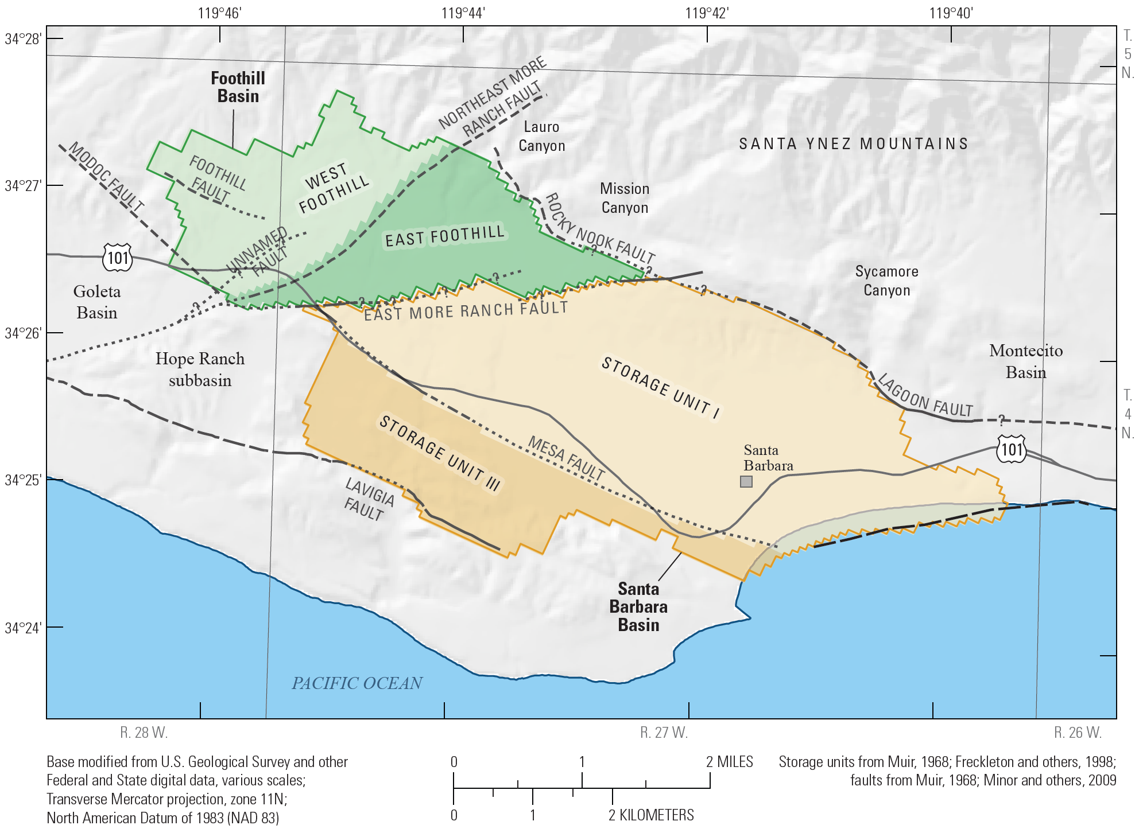
Developing a Reduced-Order Groundwater Model for Managing Seawater Intrusion in Coastal Aquifers
2022 Ineson Lecture
Mohammadali Geranmehr¹, Domenico Baù¹, Alex S. Mayer², Lauren Mancewicz³, Weijiang Yu¹
¹ Department of Civil and Structural Engineering, University of Sheffield, Sheffield, UK
² Department of Civil Engineering, the University of Texas at El Paso, TX, USA
³ Department of Civil, Environmental, and Geospatial Engineering, Michigan Technological University, Michigan, USA
1. Basics and introduction
4. Flowchart
Water management in densely populated coastal regions is one of the most pressing sustainability challenges worldwide. Coastal groundwater supplies are especially vulnerable to global-scale stressors, such as climate change and sea level rise, due to the potential for seawater intrusion into aquifers. Seawater intrusion analysis requires solving density-dependent flow and also solute-transport equations, simultaneously. Numerical solving of these two coupling differential equations is a massive and time-consuming task.
A surrogate model is a simple and fast model that could replace the original numerical model. It is also may know as meta-models, reduced models, model emulators, proxy models, lower fidelity models and response surfaces. There are several advantages to a surrogate model. It could approximate a complex model, computationally cheaper, which could be applicable for optimization-simulation models and uncertainty analysis. In general, there are three different categories for surrogate models as below (Asher et al., 2015): 1) Data-driven, 2) Projection-based methods and 3) Multi-fidelity based surrogates.
Using data-driven methods is very common. However, these methods are not based on the main bases of the model. In other words, these methods are black boxes, which may be inefficient and unreliable (Razavi et al., 2012). On the other side, developing multi-fidelity methods is highly complex and may produce ‘‘false’’ solutions (Farthing et al., 2012). It seems that a projection-based method is an appropriate option. Because, firstly, it is based on the original governing equations, and secondly, it’s not so complex to implement. Among all projection-based methods, Proper Orthogonal Decomposition (POD) has been widely used for groundwater simulations (McPhee & Yeh William, 2008; Siade et al., 2010; Vermeulen et al., 2004). It seems that it is an acceptable approach that could give reliable results.
2. Proper Orthogonal Decomposition (POD)
5. Henry Problem
In the POD method, the original partial differential equation will replace by a simpler system of ordinary differential equations. Now, the answer is a summation of the R number of time functions multiplied by space functions as:
Where y is the model output, which depends on space and time, a_{r} is the rth time function and φ_{r} is the rth space function, which depends on time and space, respectively. The more R, the more accurate is the surrogate model. However, there is an optimal value for R, which could be found by sensitivity analysis. As depicted in Fig. 1, a POD method can be done in the following steps:
The POD Model has been validated by simulating conditions to the classic the Henry's problem (Croucher et al., 1995), which is a steady-state solution for the "h" and "C" state variables. The validation in transient state is conducted by comparing the POD solution to the full scale SEAWAT output.
(1)
a)
a) Create snapshots, which means producing some results from the original model in different time steps.
b) Use SVD (singular value decomposition) and calculate U matrix elements, i.e. space functions
c) Replace equation 1 in the original differential equation(s) and create a new system of simpler ordinary differential equations.
d) For each time step, solve the new system of differential equations to find time functions
b)
Fig. 1. POD aproach adapted from Li et al. (2013)
Fig. 2. Henry problem, a) Head and b) Concentration
3. Methodology
6. Santa Barbara Groundwater Basins
Main Equations: Based on SEAWAT
Hydraulic:
Darcy:
Solute-Transport:
POD Approximation
Hydraulic:
Solute-Transport:
Apply POD (Boyce et al., 2014)
Main model (based on finite difference discretization) and the projected model to a reduced space by substituting h=Ph_{r}: and C=P’C_{r}:
The current research's next step is applying POD to the Santa Barbara groundwater basin. Then the POD model will be coupled with an optimization algorithm to manage the seawater intrusion.
(2)
(3)
(4)
(5)
(6)
(7)
(8)
Fig. 3. Santa Barbara groundwater basin (Paulinski et al., 2018)
7. Acknowledgements
Some of the authors of this study have been supported in part by the UK EPSRC grant EP/T018542/1 and the US NSF grant 2022278.
8. References
Boyce, Scott E., & Yeh, William W. G. (2014). Parameter-independent model reduction of transient groundwater flow models: Application to inverse problems. Advances in Water Resources, 69, 168-180.
Croucher, A. E., & O'Sullivan, M. J. (1995). The Henry Problem for Saltwater Intrusion. Water Resources Research, 31(7), 1809-1814.
Li, Xinya, Chen, Xiao, Hu, Bill X., & Navon, I. Michael. (2013). Model reduction of a coupled numerical model using proper orthogonal decomposition. Journal of Hydrology, 507, 227-240.
Paulinski, Scott R., Nishikawa, Tracy, Cromwell, Geoffrey, Boyce, Scott E., & Stanko, Zachary P. (2018). Santa Barbara and Foothill groundwater basins Geohydrology and optimal water resources management—Developed using density dependent solute transport and optimization models (2018-5059). Retrieved from Reston, VA: http://pubs.er.usgs.gov/publication/sir20185059

