Slide 1
Comparison of off-line and on-line trained Gaussian process (GP) models for island groundwater management
Weijiang Yu
University of Sheffield, UK

Slide 2
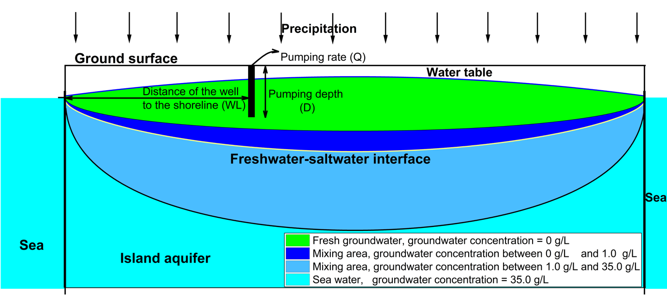
Island groundwater management problem
Management objective:
Minimize the operation cost of using island groundwater ($f_{OC}$)
$f_{OC}\left(WL, D,Q\right)=f_{p}\left(Q,h,C\right)+f_{t}\left(Q,C\right)$
Subject to:
Pct freshwater volume decrease = $∆FV$ $≤$ $∆{FV}_{limit}$
Pumping intensity Q $≥{\text{Q}}_{demand}$
(RCH)
Simulation-optimization system
Numerous SEAWAT runs
Horrible computational cost
L = 1000 m

Slide 3
Framework of solving management problem by off-line and on-line trained GPs
Initial training sample
Run full-scale model
Develop GPs for objective function and constraints
Off-line training route
On-line training route
Optimization solver
Run full-scale model
Identify new training points based on GP ${CV}_{max}$
Run full-scale model
Optimal solution (WL, D) as new training point
Update training points
${CV}_{avg}$ $≤$ Tolerance
Update training points
Optimization solver
$\left\|{DV}_{i}^{opt}−{DV}_{i−1}^{opt}\right\|≤$ Tolerance
Optimal solution (WL, D)
Optimal solution (WL, D)

Slide 4
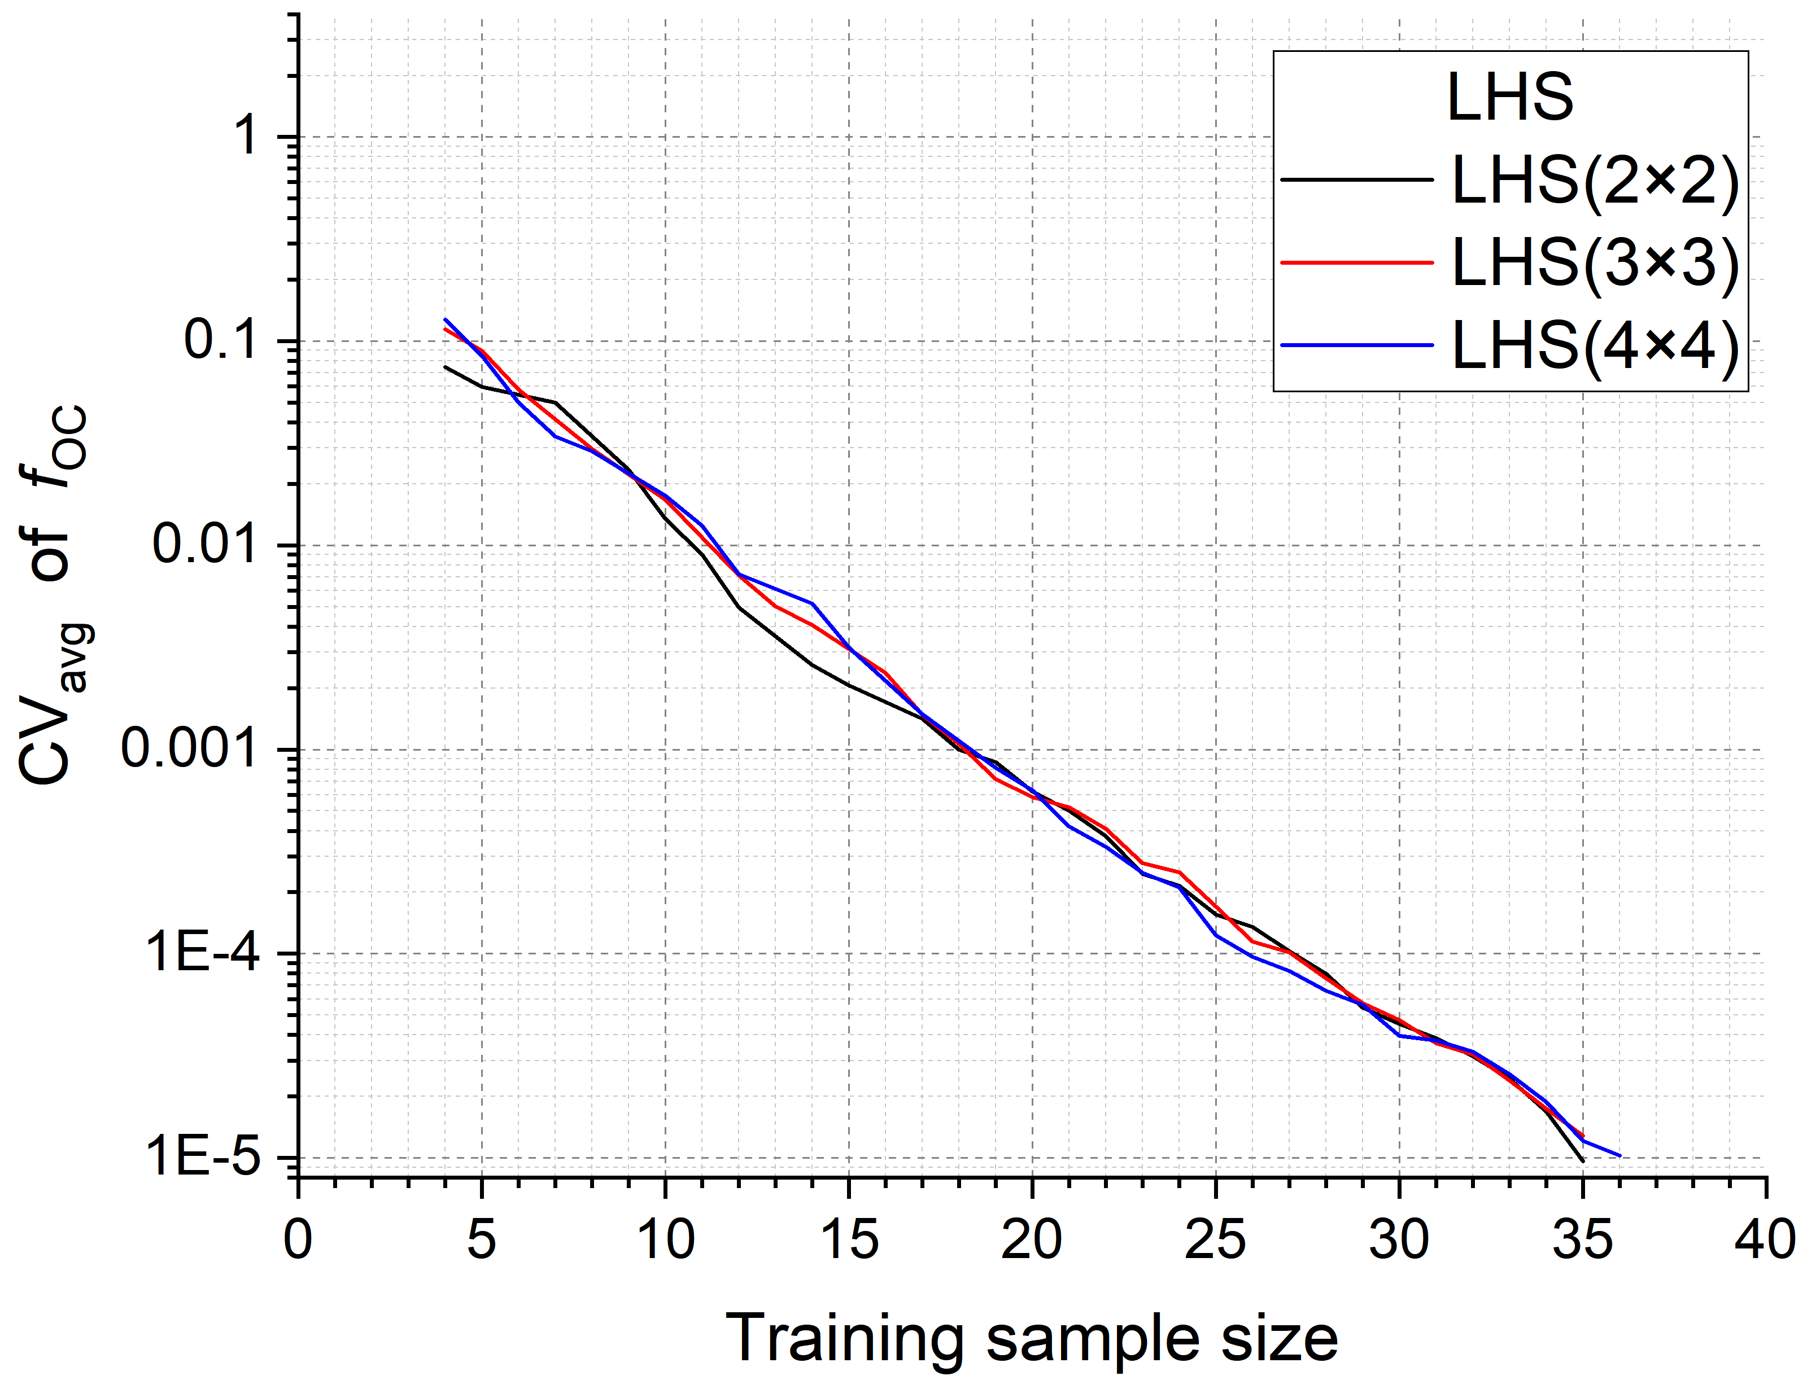
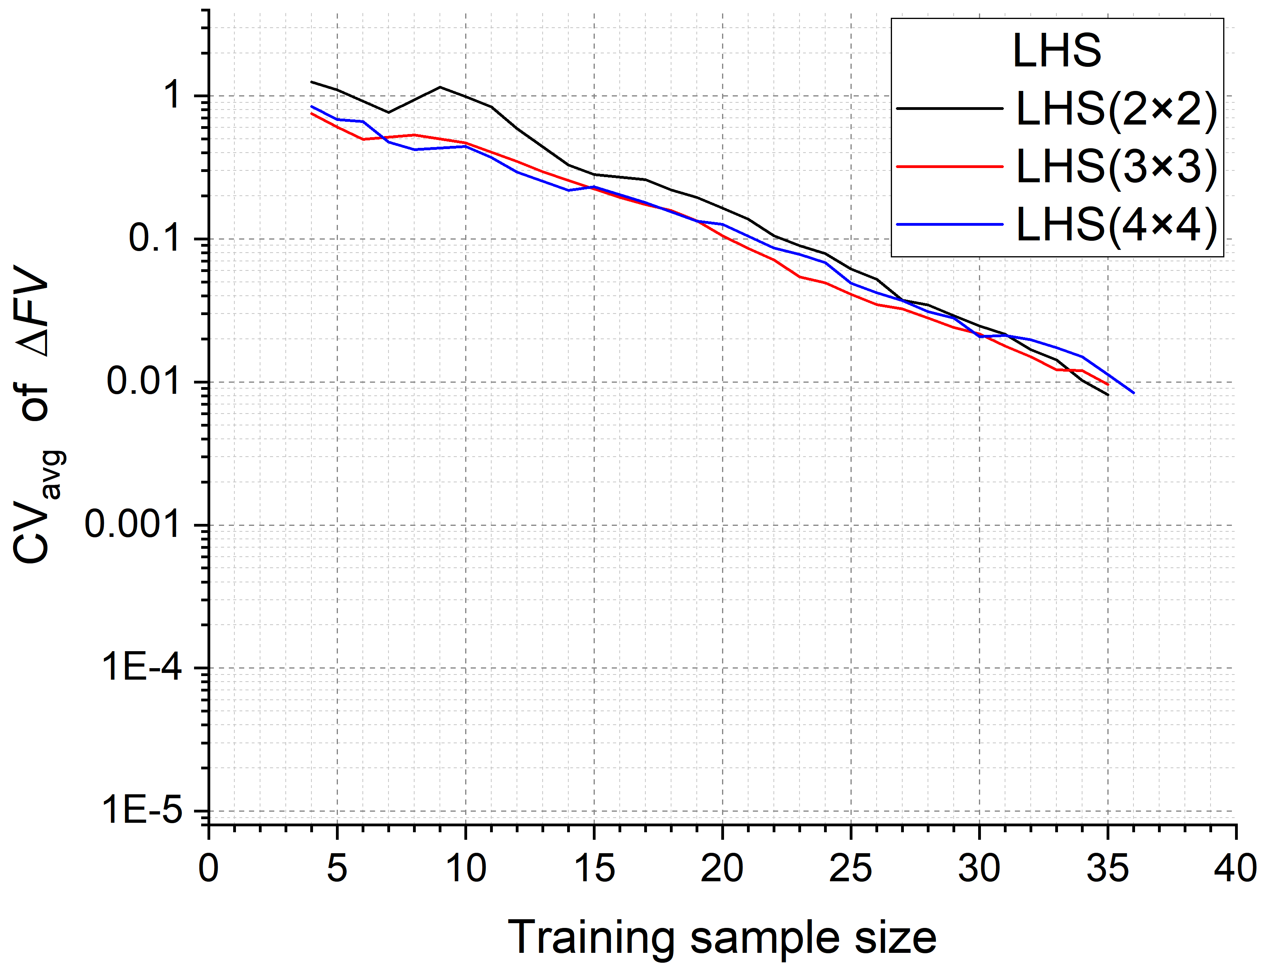
Off-line training framework ${\text{Q}}_{demand}$ = 0.1$∙$RCH$∙$L, $∆{FV}_{limit}$ = 15%
Initial sample size = 4
LHS | Optimal Pumping (WL, D) | $f_{OC}$ ($\$/(m∙year)$) | $∆FV$ (%)
$$2×2$$ | ( 260 m, 4 m) | 0.003574 | 13.23
$$3×3$$ | ( 300 m, 5 m) | 0.003491 | 13.82
$$4×4$$ | ( 270 m, 4 m) | 0.003560 | 13.68

Slide 5
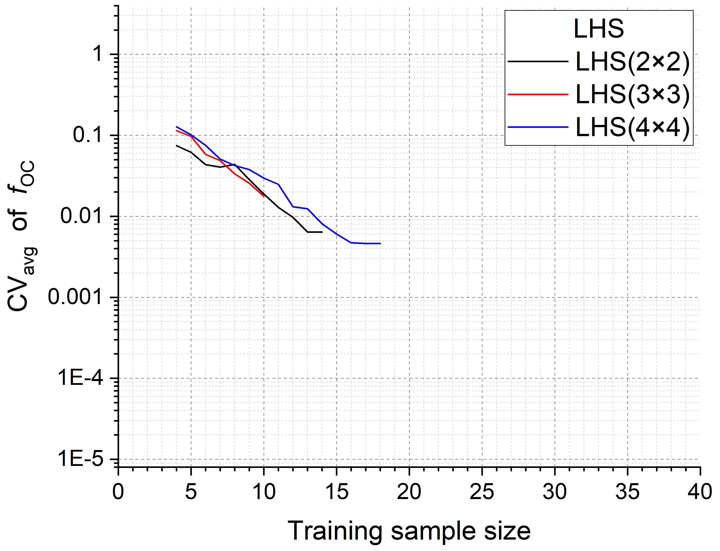
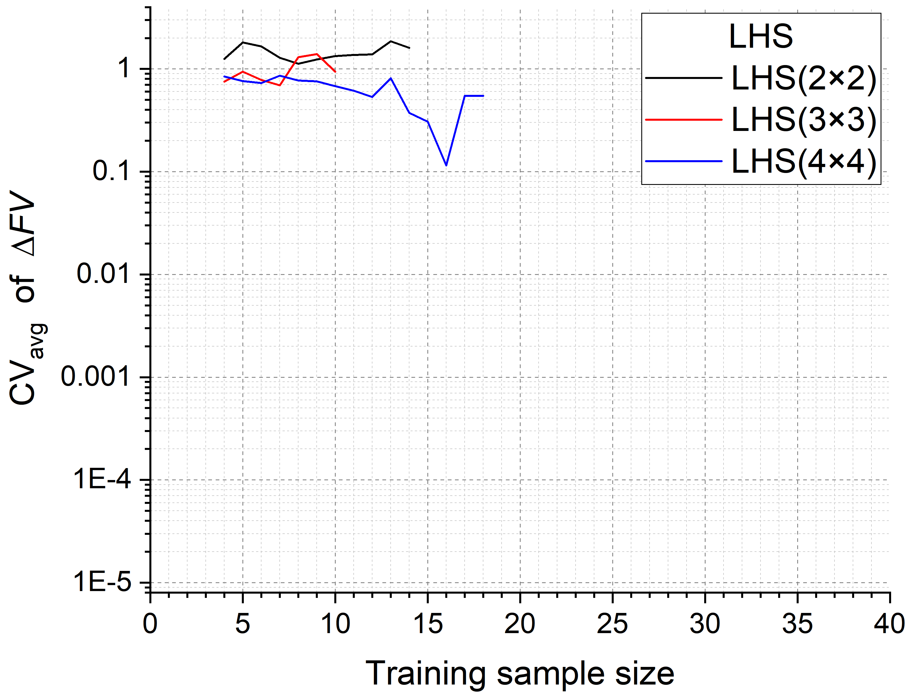
On-line training framework ${\text{Q}}_{demand}$ = 0.1$∙$RCH$∙$L, $∆{FV}_{limit}$ = 15%
Initial sample size = 4
LHS | Optimal Pumping (WL, D) | $f_{OC}$ ($\$/(m∙year)$) | $∆FV$ (%)
$$2×2$$ | ( 50 m, 1 m) | 0.035432 | 1.81
$$3×3$$ | ( 410 m, 10 m) | 0.064358 | 14.67
$$4×4$$ | ( 280 m, 1 m) | 0.003558 | 13.90

Slide 6
Conclusions
In the off-line training framework, optimal solutions from all LHS cases are close and reliable.
On-line training framework search for the optimal solution at a cheaper cost compared with the off-line training, but the results are less reliable. To get a reliable solution, initial samples should from the case of LHS($4×4$) when using on-line training system.

